Slide 1
Chapter 5: Integration
Contents:
5.1 Approximating and Computing Area
5.2 The Definite Integral
5.3 The Indefinite Integral
5.4 The Fundamental Theorem of Calculus, Part I
5.5 The Fundamental Theorem of Calculus, Part II
5.6 Net Change as the Integral of a Rate of Change
5.7 The Substitution Method
5.8 Further Integral Formulas

Slide 2
5.1 Approximating and Computing Area
Why might we be interested in the area under a graph? Consider an object moving in a straight line with constant positive velocity v. The distance traveled over a time interval [t₁, t₂] is equal to vΔt, where Δt = (t₂ − t₁) is the time elapsed. This is the well-known formula
distance traveled = velocity × time elapsed = v∆t
Because v is constant, the graph of velocity is a horizontal line (Figure 1 on next slide) and vΔt is equal to the area of the rectangular region under the graph of velocity over [t₁, t₂]. So we can write the last equation as
distance traveled = area under the graph of velocity over [t₁, t₂]

Slide 3
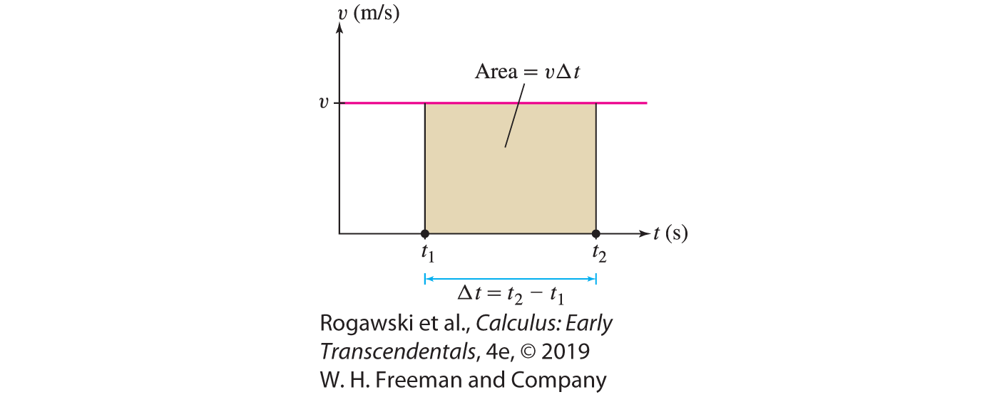
5.1 Approximating and Computing Area
There is, however, an important difference between these two equations: The first makes sense only if velocity v is constant, whereas the second is correct even if the velocity changes with time. Thus, the advantage of expressing distance traveled as an area is that it enables us to deal with much more general types of motion.

Slide 4
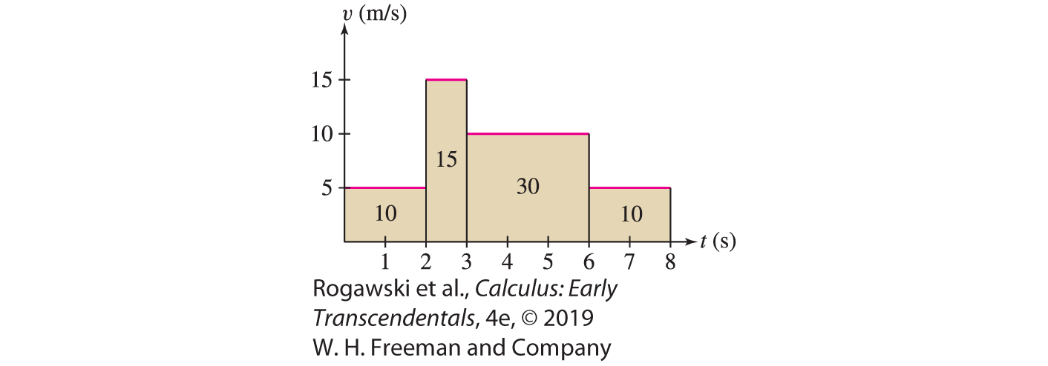
5.1 Approximating and Computing Area
To see why the second equation might be true in general, let’s consider the case where velocity changes over time but is constant on intervals. In other words, we assume that the object’s velocity changes abruptly from one interval to the next as in Figure 2. The distance traveled over each time interval is equal to the area of the rectangle above that interval, so the total distance traveled is the sum of the areas of the rectangles. In Figure 2, the distance traveled over [0, 8] s = 10 + 15 + 30 + 10 = 65 m.

Slide 5
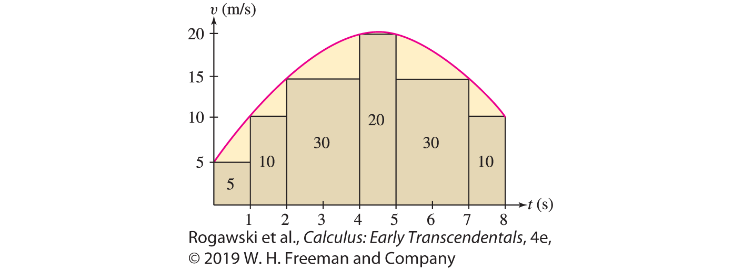
5.1 Approximating and Computing Area
Our strategy when velocity changes continuously (Figure 3) is to approximate the area under the graph by a sum of areas of rectangles. We can continually improve the approximation by using thinner and thinner rectangles, and then take a limit to obtain an exact value for the distance traveled. This idea leads to the concept of an integral.

Slide 6
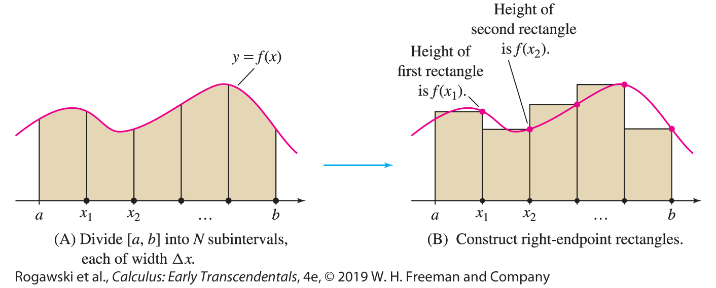
5.1 Approximating and Computing Area
Our goal is to compute the area under the graph of a function f. In this section, we assume that f is continuous. We fix a number N and divide [a, b] into N subintervals of equal width, as in Figure 4(A). The full interval [a, b] has width b − a, so each subinterval has width Δx = (b − a)/N. The right endpoints of the subintervals are
x₁ = a + Δx, x₂ = a + 2Δx, ..., x_{N −1} = a + (N − 1)Δx, x_{N} = a + NΔx

Slide 7
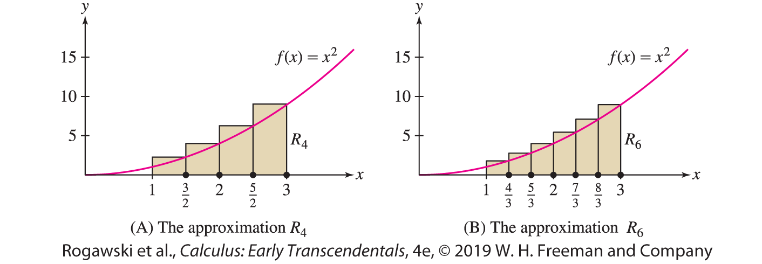

5.1 Approximating and Computing Area
EXAMPLE: We calculate R₄ and R₆ for f (x) = x ² on the interval [1, 3]. For R₄, we divide [1, 3] into four subintervals of width $Δx = \frac{3 − 1}{4} =\frac{1}{2}$ . The right endpoints are the numbers x = a + jΔx = 1 + j $\frac{1}{2}$for j = 1, 2, 3, 4. They are spaced at intervals of $\frac{1}{2}$ beginning at 3, so, as we see in Figure 5(A), the right endpoints are $\frac{3}{2}$ , $\frac{4}{2}$ , $\frac{5}{2}$ , $\frac{6}{2}$ . R₄ is Δx times the sum of the function values at the right endpoints:
$$R_{4}=\frac{1}{2}\left(f\left(\frac{3}{2}\right)+f\left(\frac{4}{2}\right)+f\left(\frac{5}{2}\right)+f\left(\frac{6}{2}\right)\right)$$
$$=\frac{1}{2}\left(\frac{9}{4}+ \frac{16}{4}+\frac{25}{4}+\frac{36}{4}\right)=\frac{43}{4}$$

Slide 8

5.1 Approximating and Computing Area
For R₆, we divide [1, 3] into six subintervals of width $Δx = \frac{3 − 1}{6} =\frac{1}{3}$ . The right endpoints are the numbers x = a + jΔx = 1 + j $\frac{1}{3}$for j = 1, 2, 3, 4, 5, 6. They are spaced at intervals of $\frac{1}{3}$ beginning at 3 , so, as we see in Figure 5(B), the right endpoints are $\frac{4}{3}$ , $\frac{5}{3}$ , $\frac{6}{3}$ , $\frac{7}{3}$, $\frac{8}{3}, \frac{9}{3}$. R₆ is Δx times the sum of the function values at the right endpoints:
$$R_{4}=\frac{1}{2}\left(f\left(\frac{4}{3}\right)+f\left(\frac{5}{3}\right)+f\left(\frac{6}{3}\right)+f\left(\frac{7}{3}\right)+f\left(\frac{8}{3}\right)+f\left(\frac{9}{3}\right)\right)=\frac{1}{3}\left(\frac{16}{9}+ \frac{25}{9}+\frac{36}{9}+\frac{49}{9}+\frac{64}{9}+\frac{81}{9}\right)=\frac{271}{27}.$$

Slide 9

5.1 Approximating and Computing Area
Summation notation is a standard notation for writing sums in compact form. The sum of numbers a_{m} , ... , a_{n} (m ≤ n) is denoted
$$\sum_{i=m}^{n}{\text{a} \text{i} \text{=} \text{a}\text{m} \text{+} \text{a}\text{m}\text{+}\text{1} \text{+} \text{··}\text{·} \text{+} \text{a}\text{n} }$$
The Greek letter Σ (capital sigma) stands for “sum,” and the notation $\sum_{i=m}^{n}{a_{i}}$ tells us to start the summation at j = m and end it at j = n. For example,
$$\sum_{j=1}^{5}{j^{2}=1+4+9+16+25}=55$$
In this summation, the jth term is a _{j} = j². We refer to j² as the general term. The letter j is called the summation index. It is also referred to as a dummy variable because any other letter can be used instead.

Slide 10

5.1 Approximating and Computing Area
For example,
$$\sum_{k=4}^{6}{\left(k^{2}−2k\right)=\left(16−8\right)+\left(25−10\right)+\left(36−12\right)=47}$$
$$\sum_{k=1}^{3}{1}=1+1+1=3$$

Slide 11

5.1 Approximating and Computing Area
Linearity of Summations
$$\sum_{k=m}^{n}{\left(a_{k}±b_{k}\right)}=\sum_{k=m}^{n}{a_{k}}±\sum_{k=m}^{n}{b_{k}}$$
$$\sum_{k=m}^{n}{(ca_{k})}=c\sum_{k=m}^{n}{a_{k}}$$
$$\sum_{k=1}^{n}{c}=c∙n$$

Slide 12

5.1 Approximating and Computing Area
For example, $\sum_{j=3}^{5}{(j^{2}+j)}=\sum_{j=3}^{5}{j^{2}+\sum_{j=3}^{5}{j}=\left(9+16+25\right)+\left(3+4+5\right)=62}.$
The linearity properties can be used to write a single summation as a linear combination of several summations: $\sum_{k=1}^{100}{(7k^{2}−4k+9)}=7\sum_{k=1}^{100}{k^{2}}−4\sum_{k=1}^{100}{k}+9\sum_{k=1}^{100}{1}.$
It is convenient to use summation notation when working with area approximations.
For example, R_{N} is a sum with general term f (x_{j}): R_{N} = Δx ( f (x₁) + f (x₂) + ··· + f (x_{N})). The summation extends from j = 1 to j = N , so we can write R_{N} concisely as
$$R_{N}=∆x\sum_{j=1}^{N}{f(x_{j})}$$

Slide 13
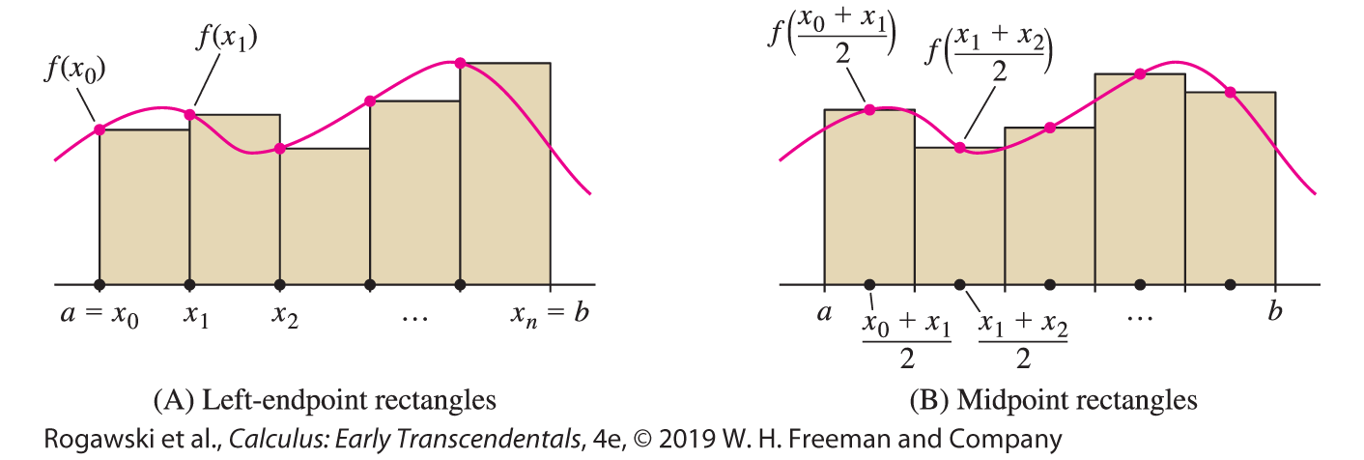

5.1 Approximating and Computing Area
We shall make use of two other rectangular approximations to area: the left-endpoint and the midpoint approximations. Divide [a, b] into N subintervals as before. In the left-endpoint approximation L_{N} , the heights of the rectangles are the values of f (x) at the left endpoints [Figure 6(A)]. These left endpoints are
x₀ = a, x₁ = a + Δx , x₂ = a + 2Δx , ... , x_{N −1} = a + (N − 1)Δx
and the sum of the areas of the left-endpoint rectangles is
$$L_{N}=∆x\left(f\left(x_{0}\right)+f\left(x_{1}\right)+⋯+f\left(x_{N−1}\right)\right)=∆x\sum_{j=0}^{N−1}{f\left(x_{j}\right)}$$

Slide 14

5.1 Approximating and Computing Area
In the midpoint approximation M_{N} , the heights of the rectangles are the values of f (x) at the midpoints of the subintervals rather than at the endpoints. As we see in Figure 6(B), the midpoints are
$$\frac{x_{0}+x_{1}}{2},\frac{x_{1}+x_{2}}{2}, ⋯,\frac{x_{N−1}+x_{N}}{2}$$
The sum of the areas of the midpoint rectangles is
$$M_{N}=∆x\left(f\left(\frac{x_{0}+x_{1}}{2}\right)+f\left(\frac{x_{1}+x_{2}}{2}\right)+⋯+f\left(\frac{x_{N−1}+x_{N}}{2}\right)\right)=∆x\sum_{j=1}^{N}{f\left(\frac{x_{j−1}+x_{j}}{2}\right)}$$

Slide 15
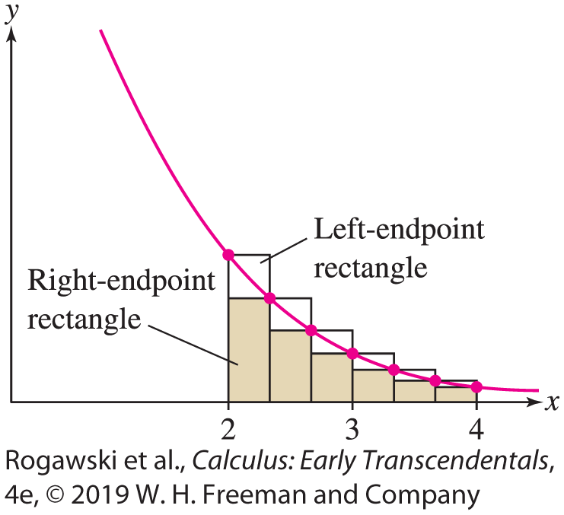

5.1 Approximating and Computing Area
EXAMPLE: We calculate R₆, L₆, and M₆ for f (x ) = x ⁻¹ on [2, 4]. In this case,
Δx = (b − a)/N = (4 − 2)/6 = 1/3 and the right endpoints of the interval are
$\frac{7}{3},\frac{8}{3},\frac{9}{3}=3,\frac{10}{3},\frac{11}{3},\frac{12}{3}=4$ while the left endpoints are $\frac{6}{3}=2,\frac{7}{3},\frac{8}{3},\frac{9}{3}=3,\frac{10}{3},\frac{11}{3}$. Therefore, $R_{6}=$ $\frac{1}{3}(f\left(\frac{7}{3}\right)+f\left(\frac{8}{3}\right)+f\left(\frac{9}{3}\right)+f\left(\frac{10}{3}\right)+f\left(\frac{11}{3}\right)+f\left(\frac{12}{3}\right))$
$=\frac{1}{3}\left(\frac{3}{7}+\frac{3}{8}+\frac{3}{9}+\frac{3}{10}+\frac{3}{11}+\frac{3}{12}\right)$≈ 0.653
$L_{6}=$ $\frac{1}{3}(f\left(\frac{6}{3}\right)+f\left(\frac{7}{3}\right)+f\left(\frac{8}{3}\right)+f\left(\frac{9}{3}\right)+f\left(\frac{10}{3}\right)+f\left(\frac{11}{3}\right))$
$$=\frac{1}{3}\left(\frac{3}{6}+\frac{3}{7}+\frac{3}{8}+\frac{3}{9}+\frac{3}{10}+\frac{3}{11}\right)\text{≈} \text{0.737}$$

Slide 16
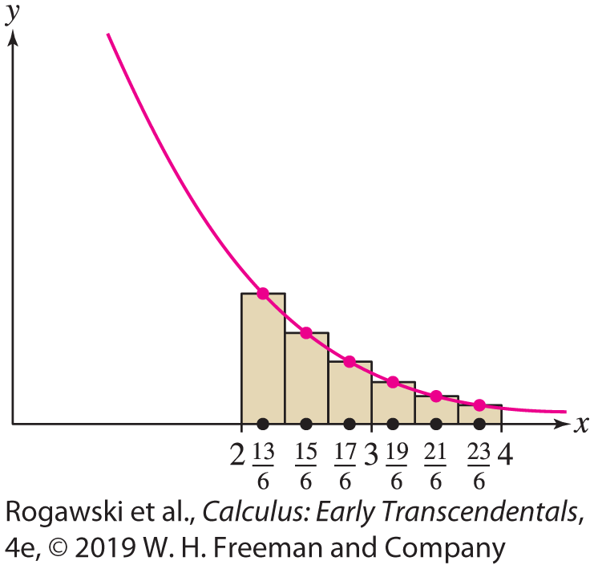

5.1 Approximating and Computing Area
The general term in M₆ is $f(\frac{x_{j − 1} + x_{j}}{2})$ and the midpoints are $\frac{13}{6},\frac{15}{6},\frac{17}{6},\frac{19}{6},\frac{21}{6},\frac{23}{6}$. Summing from j = 0 to 5, we obtain
$M_{6}=\frac{1}{3}(f\left(\frac{13}{6}\right)+f\left(\frac{15}{6}\right)+f\left(\frac{17}{6}\right)+f\left(\frac{19}{6}\right)+f\left(\frac{21}{6}\right)+f\left(\frac{23}{6}\right))$
$$=\frac{1}{3}\left(\frac{6}{13}+\frac{6}{15}+\frac{6}{17}+\frac{6}{19}+\frac{6}{21}+\frac{6}{23}\right)\text{≈} \text{0.692}$$

Slide 17
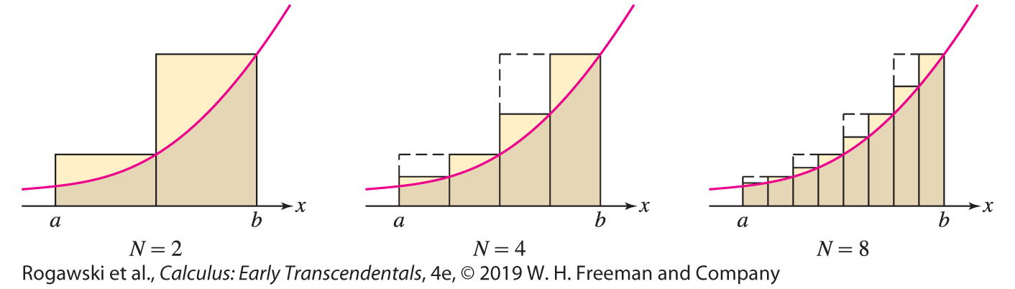
5.1 Approximating and Computing Area
Figure 10 shows several right-endpoint approximations. Notice that the error in computing the area, corresponding to the yellow region above the graph, gets smaller as the number of rectangles increases. In fact, it appears that we can make the error as small as we please by taking the number N of rectangles large enough. If so, it makes sense to consider the limit as N → ∞, as this should give us the exact area under the curve. The next theorem guarantees that the limit exists.

Slide 18

5.1 Approximating and Computing Area
THEOREM: If f is continuous on [a, b], then the endpoint and midpoint approximations approach one and the same limit as N → ∞. In other words, there is a value L such that
$$\lim_{N→∞}{R_{N}}=\lim_{N→∞}{L_{N}}=\lim_{N→∞}{M_{N}}=L$$
If f (x ) ≥ 0 on [a, b], we define the area under the graph over [a, b] to be L.

Slide 19

5.1 Approximating and Computing Area
The next three examples illustrate the last theorem using formulas for power sums. The kth power sum is defined as the sum of the kth powers of the first N integers. We shall use the power sum formulas for k = 1, 2, 3.
$$\sum_{k=1}^{N}{k}=\frac{N(N+1)}{2}$$
$$\sum_{k=1}^{N}{k^{2}}=\frac{N(N+1)(2N+1)}{6}$$
$$\sum_{k=1}^{N}{k^{3}}=\frac{N^{2}{(N+1)}^{2}}{4}$$
For instance, $\sum_{k=1}^{6}{k^{2}}=\frac{6 ∙ 7 ∙ 13}{6}=91.$

Slide 20
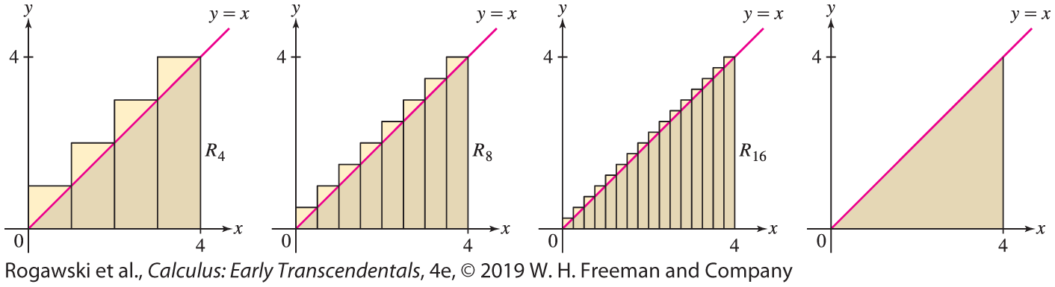

5.1 Approximating and Computing Area
EXAMPLE: We compute the area of a right triangle, a figure whose area we can also compute geometrically. To find the area A under the graph of f (x) = x over [0, 4], we observe that this is a triangle with base 4 and height 4, so $A=\frac{1}{2}∙4∙4=8.$

Slide 21

5.1 Approximating and Computing Area
We compute this area again as a limit. Since Δx = (b − a)/N = 4/N and f (x) = x , we have $f\left(x_{j}\right)=f\left(0+j∆x\right)=\frac{4j}{N}.$ Therefore,
$R_{N}=\frac{4}{N}\sum_{j=1}^{N}{\frac{4j}{N}}=\frac{16}{N^{2}}\sum_{j=1}^{N}{j}=\frac{16}{N^{2}}\frac{N(N + 1)}{2}=8\frac{N + 1}{N}→8 as N→∞$
The left-endpoint approximation is similar, but the sum begins at j = 0 and ends at j = N − 1:
$$L_{N}=\frac{4}{N}\sum_{j=0}^{N−1}{\frac{4j}{N}}=\frac{16}{N^{2}}\sum_{j=1}^{N−1}{j}=\frac{16}{N^{2}}\frac{\left(N−1\right)N}{2}=8\frac{N−1}{N}→8 as N→∞$$

Slide 22
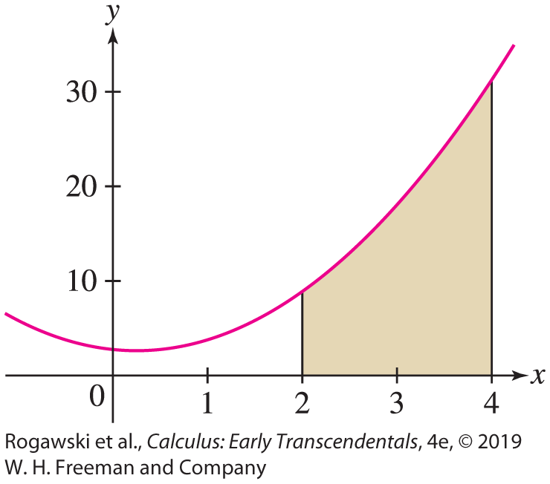

5.1 Approximating and Computing Area
EXAMPLE: We compute the area A under the graph of f (x) = 2x ² − x + 3 over [2, 4] using $\lim_{N→∞}{R_{N}}.$ In this case, Δx = (4 − 2)/N = 2/N and $x_{j}=2+\frac{2j}{N}.$ Therefore,
$f\left(2+\frac{2j}{N}\right)=2{\left(2+\frac{2j}{N}\right)}^{2}−2−\frac{2j}{N}+3=\frac{8j^{2}}{N^{2}}+\frac{14j}{N}+9$
We obtain $R_{N}=\frac{2}{N}\sum_{j−1}^{N}{f(x_{j}})=\frac{2}{N}\sum_{j=1}^{N}{(\frac{8j^{2}}{N^{2}}+\frac{14j}{N}+9) }$
$=\frac{16}{N^{3}}\sum_{j=1}^{N}{j^{2}}+\frac{28}{N^{2}}\sum_{j=1}^{N}{j}+\frac{18}{N}\sum_{j=1}^{N}{1}$
$=\frac{16}{N^{3}}\frac{N(N + 1)(2N+ 1 )}{6}+\frac{28}{N^{2}}\frac{N(N + 1)}{2}+\frac{18}{N}N$
$=\frac{8}{3}\frac{(N + 1)(2N + 1)}{N^{2}}+14\frac{N + 1}{N}+18→\frac{16}{3}+14+18=\frac{112}{3} as N→∞$

Slide 23
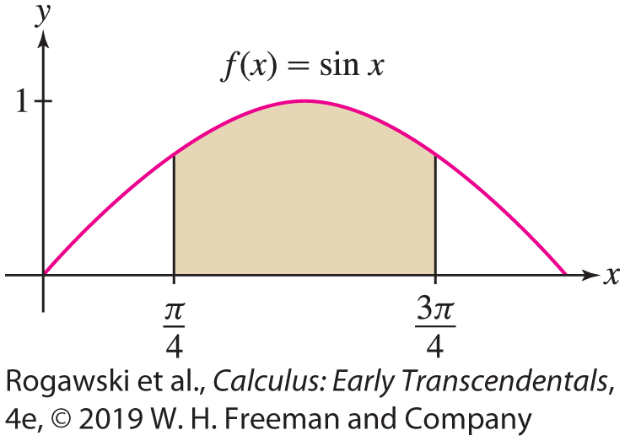

5.1 Approximating and Computing Area
EXAMPLE: Let A be the area under the graph of f (x) = sin x on the interval $\left[\frac{π}{4}, \frac{3π}{4}\right].$In this case, Δx = (3π/4 − π/4)/N = π/(2N ) and the area A is
$$A=\lim_{N→∞}{R_{N}}=\lim_{N→∞}{∆x}\sum_{j=1}^{N}{f\left(x_{j}\right)}=\frac{π}{2N}\sum_{j=1}^{N}{\sin\left(\frac{π}{4}+\frac{πj}{2N}\right)}$$
The limit in the previous example is difficult to compute;
however, it can be approximated by computing R_{N} for
large N. In Section 5.4, we will see that this area is
straightforward to compute (and is $\sqrt{2}$) using the definite
integral and the Fundamental Theorem of Calculus.

Slide 24
5.2 The Definite Integral (1 of 26)
In a moment, we will state formally that L is the definite integral of f over [a, b]. Before doing so, we introduce Riemann sums, sums that are structured similar to the approximating sums L_{N}, R_{N} , and M_{N} , and that generalize them.
Recall that R_{N} , L_{N} , and M_{N} use rectangles of equal width Δx , whose heights are the values of f (x) at the endpoints or midpoints of the subintervals. In Riemann sums, we relax these requirements: The rectangles need not have equal width, f (x) can have any real-number value, and the height (which could be negative) may be any value of f (x) within the subinterval.
Sample points C = {c₁, ... , c_{N} }: c_{i} belongs to the subinterval [x_{i −1}, x_{i} ] for all
i = 1, ... , N (and could be any point in the subinterval). See Figures 1 and 2(A). The length of the ith subinterval [x_{i−1}, x_{i}] is Δx_{i} = x_{i} − x_{i-1}

Slide 25
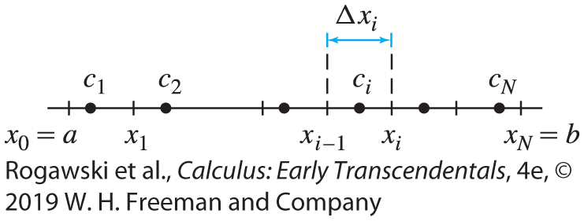
5.2 The Definite Integral (2 of 26)
The norm of the partition P, denoted || P||, is the maximum of the lengths ∆x_{i} .
Given P and C, as Figure 2(B) illustrates, on each subinterval [x_{i−1}, x_{i} ] we have a rectangle whose height is f (c_{i} ). We allow the possibility that f (c_{i} ) < 0. For each rectangle, we refer to f(c_{i} )∆ x_{i} as its signed area. Note that
If f (c_{i} ) > 0, the signed area is positive and is equal to the area of the rectangle.
If f (c_{i} ) < 0, then the signed area is negative and is equal to the negative of the area of the rectangle.

Slide 26
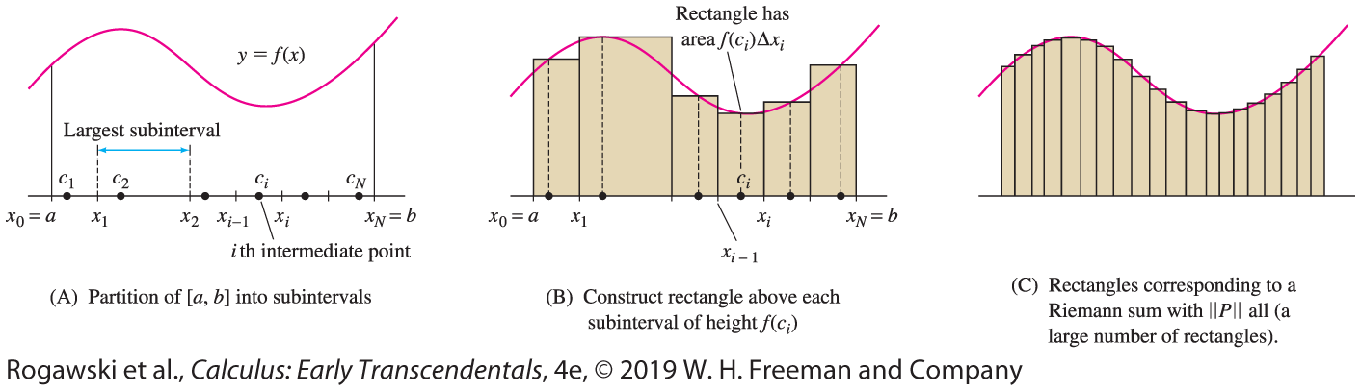

5.2 The Definite Integral (3 of 26)
The Riemann sum is the sum of the f (c_{i})∆ x_{i} terms that are determined by P and C, and it is expressed as
$$R\left(f,P,C\right)=\sum_{i=1}^{N}{f\left(c_{i}\right)∆x_{i}=f(c_{1})∆x_{1}}+f\left(c_{2}\right)∆x_{2}+⋯+f(c_{N})∆x_{N}$$

Slide 27
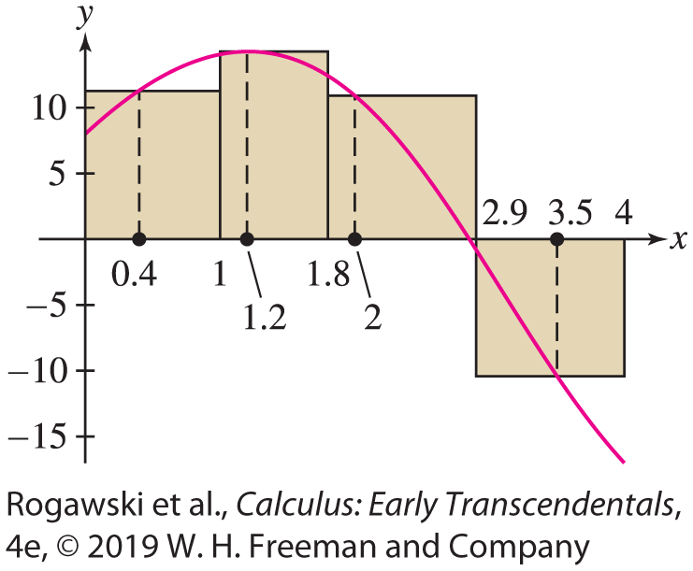

5.2 The Definite Integral (4 of 26)
EX AMPLE : We calculate the Riemann sum R( f, P, C), where f (x) = 8 + 12 sin x − 4x
on [0, 4] and P : x₀ = 0, x₁ = 1, x₂ = 1.8, x₃ = 2.9, x₄ = 4. The widths of the subintervals in the partition (Figure 3) are ∆ x₁ = x₁ − x₀ = 1 − 0 = 1, ∆ x₂ = x₂ − x₁ = 1.8 − 1 = 0.8,
∆ x₃ = x₃ − x₂ = 2.9 − 1.8 = 1.1, and ∆ x₄ = x₄ − x₃ = 4 − 2.9 = 1.
Therefore, ||P|| = 1.1.
Choosing C : c₁ = 0.4, c₂ = 1.2, c₃ = 2, c₄ = 3.5, we have
$R\left(f,P,C\right)=f\left(c_{1}\right)∆x_{1}+f\left(c_{2}\right)∆x_{2}+f\left(c_{3}\right)∆x_{3}+f\left(c_{4}\right)∆x_{4}$
$$≈23.35$$

Slide 28

5.2 The Definite Integral (5 of 26)
Note in Figure 2(C) that as the norm ||P|| tends to zero (meaning that the rectangles get thinner), the number of rectangles N tends to ∞ and the sums R( f, P, C) approach a limiting value. This leads to the following definition:
DEFINITION: A function f is integrable over [a, b] if all of the Riemann sums approach one and the same limit L as ||P|| tends to zero. The limit L is called the definite integral of f over [a, b], and is denoted by $\int_{a}^{b}{f\left(x\right)dx}$. Formally, we write
$$\int_{a}^{b}{f\left(x\right)dx=}\lim_{|\left|P\right||→0}{R\left(f,P, C\right)}=\lim_{|\left|P\right||→0}{\sum_{i=1}^{N}{f(c_{i})∆x_{i}}}$$
This means that |R( f , P,C) − L| gets arbitrarily small as the norm P tends to zero, no matter how we choose the partition and sample points.

Slide 29

5.2 The Definite Integral (6 of 26)
The definite integral is often called, more simply, the integral of f over [a, b]. The process of computing integrals is called integration and f (x) is called the integrand. The endpoints a and b of [a, b] are called the limits of integration. Finally, we remark that any variable may be used as a variable of integration; that is, that variable is a dummy variable. Thus, the following three integrals all denote the same quantity:
$$\int_{a}^{b}{\sin{x}dx, }\int_{a}^{b}{\sin{t}dt, }\int_{a}^{b}{\sin{u}du }$$

Slide 30
5.2 The Definite Integral (7 of 26)
The next theorem assures us that continuous functions (and even functions with finitely many jump discontinuities) are integrable (see Appendix D for a proof). In practice, we rely on this theorem rather than attempting to prove directly that a given function is integrable.
THEOREM: If f is continuous on [a, b], or if f is continuous except at finitely many jump discontinuities in [a, b], then f is integrable over [a, b].

Slide 31
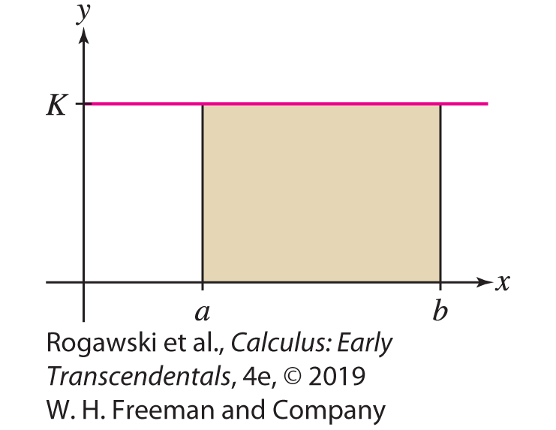

5.2 The Definite Integral (8 of 26)
A constant function f (x) = K is integrable over every interval [a, b]. The following theorem provides the value of the integral and indicates that when K is positive, the integral is the area of the rectangle in Figure 4. Since
$$R\left(f,P,C\right)=\sum_{i=1}^{N}{f(c_{i})∆x_{i}}=\sum_{i=1}^{N}{K∆x_{i}}=K(b−a)$$
we obtain $\int_{a}^{b}{Kdx}=K(b−a)$.

Slide 32

5.2 The Definite Integral (9 of 26)
We motivated the development of approximating sums, Riemann sums, and the definite integral with the problem of determining the area under the graph of a function. The definite integral provides an exact value for such areas. Specifically, if f is integrable and f (x) ≥ 0 over [a, b], then the area under the graph of f over [a, b] is $\int_{a}^{b}{f\left(x\right)dx}$.
When the geometry of a region is simple (e.g., rectangles, triangles, circles), the definite integral corresponds to the area obtained by a geometric formula, as demonstrated for a rectangle on the preceding slide. In some instances, this correspondence enables us to compute a definite integral using geometric formulas.

Slide 33
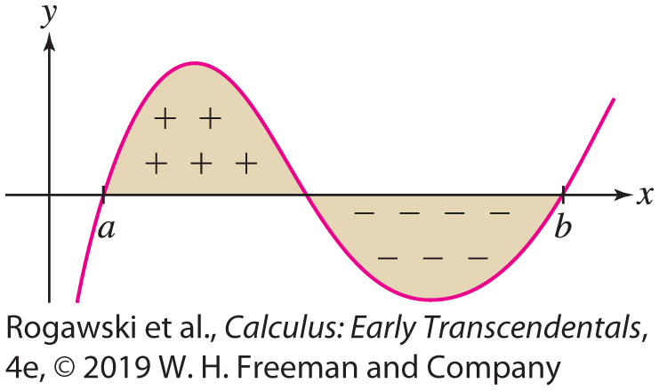

5.2 The Definite Integral (10 of 26)
Allowing the possibility that f (x) takes on both positive and negative values, we define the notion of signed area, where regions below the x-axis provide a negative contribution (Figure 5). Intuitively, the signed area of a region is the area above the x-axis minus the area below.
The f (c_{i} )∆x_{i} terms in a Riemann sum are signed areas of rectangles. Therefore, a signed area such as in Figure 5 can be approximated by Riemann sums and is given by a definite integral. Thus, for all integrable f over [a, b]:
The signed area between the graph of f
and the x -axis over [a, b] is $\int_{a}^{b}{f\left(x\right)dx}$.

Slide 34
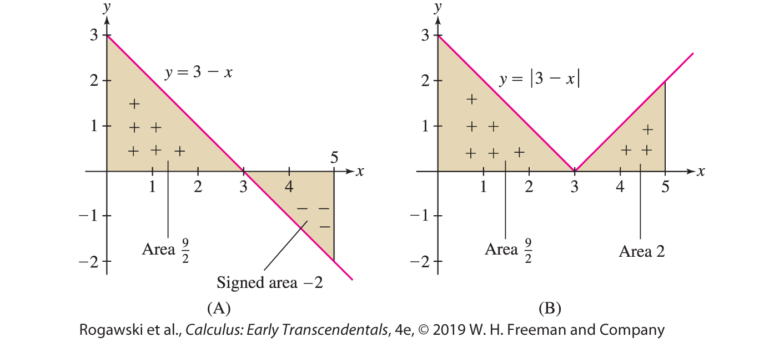

5.2 The Definite Integral (11 of 26)
EXAMPLE: We calculate $\int_{0}^{5}{\left(3 −x\right)dx}$ and $\int_{0}^{5}{|3−x|dx}$. The region between y = 3 − x and the x-axis consists of two triangles of areas$\frac{9}{2}$ and 2 [Figure 6(A)]. The triangle with area $\frac{9}{2}$ lies above the x -axis and therefore has signed area $\frac{9}{2}$ . The second triangle lies below the x -axis, so it has signed area −2. In the graph of y = |3 − x |, both triangles lie above the x -axis [Figure 6(B)]. It follows:
$\int_{0}^{5}{\left(3 −x\right)dx}=\frac{9}{2}−2=\frac{5}{2}$
$\int_{0}^{5}{|3−x|dx}=\frac{9}{2}+2=\frac{13}{2}$

Slide 35
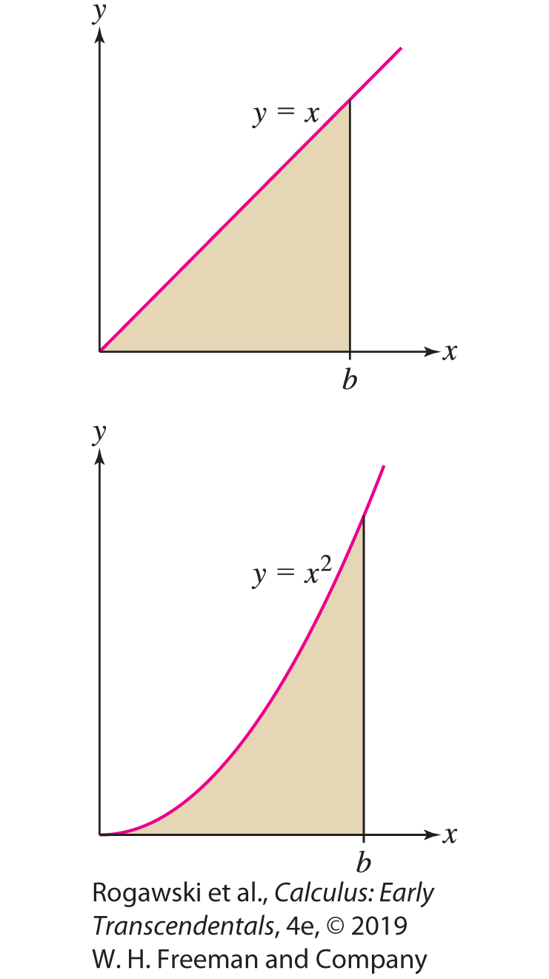

5.2 The Definite Integral (12 of 26)
EXAMPLE: To calculate $\int_{0}^{b}{xdx}$ for b > 0, observe that this integral represents the area of a triangle with base and height equal to b. Therefore, it area is $\int_{0}^{b}{xdx}=\frac{1}{2}b^{2}.$
To compute $\int_{0}^{b}{x^{2}dx,}$ we use Riemann sums. Because f(x) = x² is continuous on [0, b], it is integrable by the last theorem, and we can use right-end approximations to find the integral: We divide the interval [0, b] into N subintervals of width $∆x=\frac{b}{N}$. The right endpoints are $\frac{jb}{N}$ and
$R_{N}=\frac{b}{N}\sum_{j=1}^{N}{f\left(\frac{jb}{N}\right)=}\frac{b}{N}\sum_{j=1}^{N}{\frac{j^{2}b^{2}}{N^{2}}}=\frac{b^{3}}{N^{3}}\sum_{j=1}^{N}{j^{2}=}\frac{b^{3}}{N^{3}}\frac{N(N + 1)(2N + 1)}{6}→\frac{b^{3}}{3}$
$as N →∞$. Therefore, $\int_{0}^{b}{x^{2}dx}=\frac{1}{3}b^{3}.$

Slide 36
5.2 The Definite Integral (13 of 26)
In cases where we do not have an exact representation of a function, such as in the following example, the best we can do to compute a definite integral is to approximate it using a Riemann sum.
EXAMPLE: A Grid-Connected Energy System At their home, Melina and Hors have solar panels and an energy system that is grid connected. They use energy from their panels and from the Apollo Power Company (APC) for their household needs. When the panels are supplying more energy than they need, the excess is fed into the grid and they receive energy credit from APC. We can view their daily APC energy use E (in kilowatts) as a function of time t (in hours). When E < 0, they are supplying energy to APC.

Slide 37
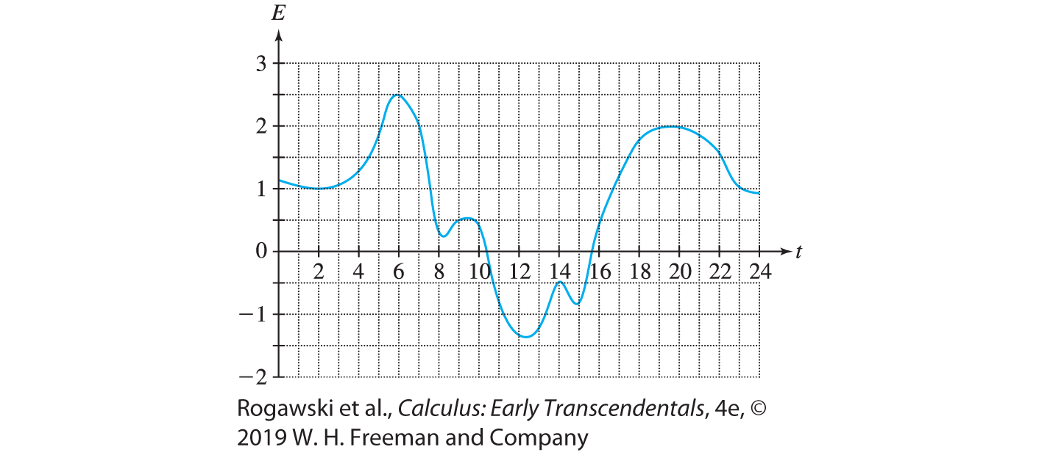

5.2 The Definite Integral (14 of 26)
Their net APC energy use over a period of time a < t < b is given by $\int_{a}^{b}{E\left(t\right)dt }$ (in kilowatt-hours). For the function E shown in the graph in Figure 8, we approximate the net APC energy use from 6:00 am (t = 6) to 6:00 pm (t = 18).

Slide 38

5.2 The Definite Integral (15 of 26)
We approximate $\int_{6}^{18}{E\left(t\right)dt }$with a left-endpoint approximation using ∆ t = 1. That sum is expressed as
$L=E\left(6\right)∆t+E\left(7\right)∆t+⋯+E(18)∆\text{t}$
$$\text{≈} \text{(2.5)(1)} \text{+} \text{(2)(1)} \text{+} \text{(0.3)(1)} \text{+} \text{(0.5)(1)} \text{+} \text{(0.4)(1)} \text{+} \text{(}\text{−}\text{0.8)(1)} \text{+}$$
$$\text{(}\text{−}\text{1.3)(1)} \text{+} \text{(}\text{−}\text{1.2)(1)} \text{+} \text{(}\text{−}\text{0.5)(1)} \text{+} \text{(}\text{−}\text{0.8)(1)} \text{+} \text{(0.3)(1)} \text{+} \text{(1.2)(1)} \text{=} \text{2.6}$$
where the values of E (t) are approximated from the graph. Therefore, the net 12-hour APC energy use is $\int_{6}^{18}{E\left(t\right)dt }\text{≈} \text{2.6 }\text{kilowatt}\text{−}\text{hours}$.

Slide 39

5.2 The Definite Integral (16 of 26)
In the rest of this section, we discuss some basic properties of definite integrals, beginning with the linearity properties.
THEOREM: Linearity of the Definite Integral If f and g are integrable over [a, b], then
f ± g and cf are integrable (for any constant c), and
$\int_{a}^{b}{\left(f\left(x\right)±g\left(x\right)\right)dx=\int_{a}^{b}{f\left(x\right)dx±\int_{a}^{b}{g\left(x\right)dx}}}$
$\int_{a}^{b}{\left(cf\left(x\right)\right)dx=c\int_{a}^{b}{f\left(x\right)dx}}$

Slide 40

5.2 The Definite Integral (17 of 26)
To see this, observe
$$R\left(f+g,P,C\right)=\sum_{i=1}^{N}{\left(f\left(c_{i}\right)+g\left(c_{i}\right)\right)∆x_{i}=\sum_{i=1}^{N}{f\left(c_{i}\right)}∆x_{i}}+\sum_{i=1}^{N}{g\left(c_{i}\right)∆x_{i}}=R\left(f,P,C\right)+R(g,P,C)$$
Using the Limit Laws yields
$$\int_{a}^{b}{\left(f\left(x\right)+g\left(x\right)\right)dx }=\lim_{|\left|P\right||→0}{R\left(f+g,P,C\right)}$$
$$=\lim_{|\left|P\right||→0}{R\left(f,P,C\right)}+\lim_{|\left|P\right||→0}{R\left(g,P,C\right)}=\int_{a}^{b}{f\left(x\right)dx+\int_{a}^{b}{g\left(x\right)dx}}$$

Slide 41

5.2 The Definite Integral (18 of 26)
EXAMPLE:
$$\int_{0}^{3}{\left(2x^{2}−3x−7\right)dx}=2\int_{0}^{3}{x^{2}dx}−3\int_{0}^{3}{x}dx−7\int_{0}^{3}{1∙dx}$$
$$=2∙\frac{3^{3}}{3}−3∙\frac{3^{2}}{2}−7∙3=−\frac{33}{2}$$

Slide 42

5.2 The Definite Integral (19 of 26)
So far, we have used the notation $\int_{a}^{b}{\text{f} \text{(}\text{x}\text{)} \text{d}\text{x}}$ with the understanding that a < b. Can we make sense of and compute integrals such as $\int_{5}^{1}{\text{f} \text{(}\text{x}\text{)} \text{d}\text{x}}$? The answer is yes. To do so rigorously involves expanding the idea of Riemann sums to allow ∆x_{i} to be negative because we are essentially integrating in a negative direction. We do not pursue the details here. For our purposes, the following definition captures the idea properly.
DEFINITION: Reversing the Limits of Integration For a < b, we set
$$\int_{b}^{a}{\text{f} \text{(}\text{x}\text{)} \text{d}\text{x}}=−\int_{a}^{b}{\text{f} \text{(}\text{x}\text{)} \text{d}\text{x}}$$

Slide 43

5.2 The Definite Integral (20 of 26)
For instance, $\int_{5}^{0}{x^{2}}dx=−\int_{0}^{5}{x^{2}dx=−\frac{5^{3}}{3}=−\frac{125}{3}}$.
Since the interval [a, a] has length 0, we get $\int_{a}^{a}{f\left(x\right)dx=0.}$
One can easily see that the formulas $\int_{0}^{b}{xdx}=\frac{1}{2}b^{2}$ and $\int_{0}^{b}{x^{2}dx}=\frac{1}{3}b^{3}$ hold for all values of b.

Slide 44
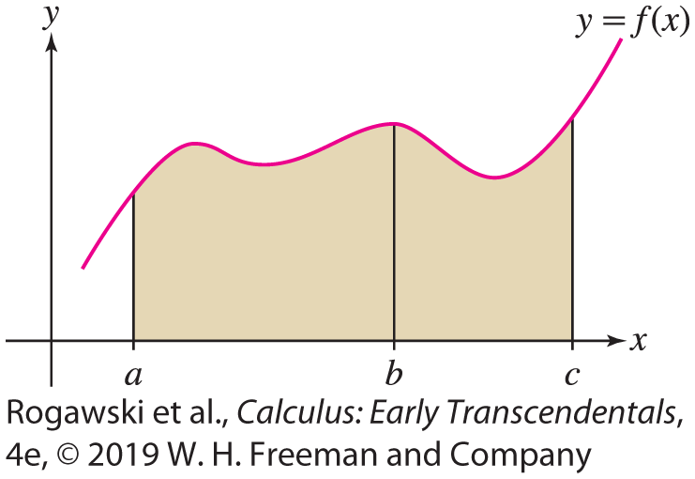

5.2 The Definite Integral (21 of 26)
Definite integrals satisfy an important additivity property: If f is integrable and a ≤ b ≤ c as in Figure 10, then the integral from a to c is equal to the integral from a to b plus the integral from b to c. We state this in the next theorem (a formal proof can be given using Riemann sums).
THEOREM: Let a ≤ b ≤ c, and assume
that f is integrable. Then
$$\int_{a}^{c}{f(x)}dx=\int_{a}^{b}{f(x)}dx+\int_{b}^{c}{f(x)}dx$$

Slide 45

5.2 The Definite Integral (22 of 26)
For instance, $\int_{0}^{7}{x^{2}}dx=\int_{0}^{4}{x^{2}}dx+\int_{4}^{7}{x^{2}}dx$, from which we get
$$\int_{4}^{7}{x^{2}}dx=\int_{0}^{7}{x^{2}}dx−\int_{0}^{4}{x^{2}}dx=\frac{7^{3}}{3}−\frac{4^{3}}{3}=93$$
Another basic property of the definite integral is that greater functions have greater
integrals (Figure 11).
THEOREM: Comparison Theorem
If f and g are integrable and g(x) ≤ f (x) for all x in [a, b], then $\int_{a}^{b}{f(x)}dx≤\int_{a}^{b}{g\left(x\right)}dx.$

Slide 46

5.2 The Definite Integral (23 of 26)
Proof
If g(x) ≤ f (x), then for any partition and choice of sample points, we have
g(c_{i})∆x_{i} ≤ f (c_{i})∆x_{i} for all i. Therefore, the Riemann sums satisfy
$R\left(g,P,C\right)=\sum_{i=1}^{N}{g(c_{i})}$∆$x_{i}$ ≤ $\sum_{i=1}^{N}{f(c_{i})∆x_{i}}=R(f,P,C)$
$$\text{Taking} \text{the} \text{limit} \text{as} \text{the} \text{norm} \text{P} \text{tends} \text{to} \text{zero}\text{, }\text{we} \text{obtain}$$
$$\int_{a}^{b}{g(x)}dx= \lim_{|\left|P\right||→0}{R(g,P,C)}≤\lim_{|\left|P\right||→0}{R\left(f,P,C\right)=\int_{a}^{b}{f\left(x\right)dx}}$$

Slide 47
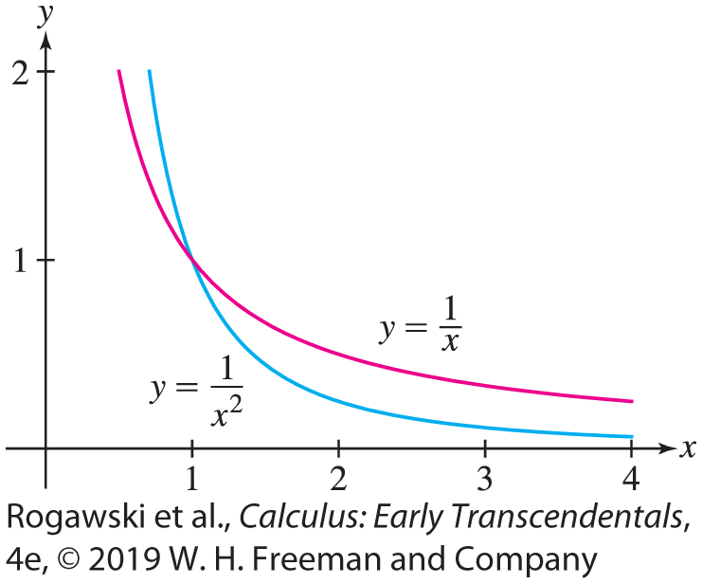

5.2 The Definite Integral (24 of 26)
For instance, $\frac{1}{x^{2}}≤\frac{1}{x}$ for all x ≥ 1. Thus, $\int_{1}^{4}{\frac{1}{x^{2}}dx}≤\int_{1}^{4}{\frac{1}{x}}dx.$

Slide 48
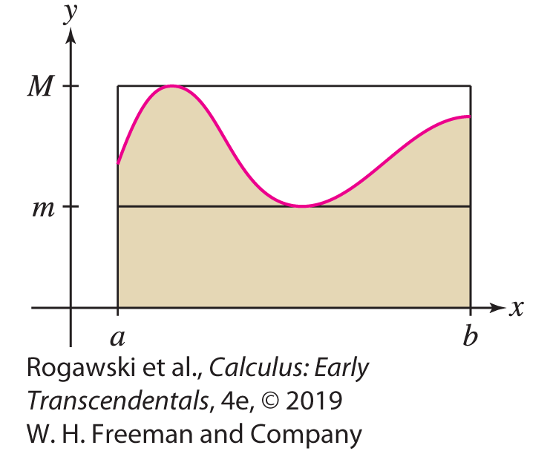

5.2 The Definite Integral (25 of 26)
Suppose there are numbers m and M such that m ≤ f (x) ≤ M for x in [a, b]. We call m and M lower and upper bounds for f (x) on [a, b]. By the Comparison Theorem,
$$m\left(b−a\right)=\int_{a}^{b}{m}dx≤\int_{a}^{b}{f\left(x\right)}dx≤\int_{a}^{b}{M}dx=M\left(b−a\right)$$
This says simply that if f (x) ≥ 0 over [a, b], then
(as in Figure 13) the integral of f lies between the
areas of two rectangles, one of height M enclosing
the region associated with the integral, and one of
height m enclosed in the region.

Slide 49
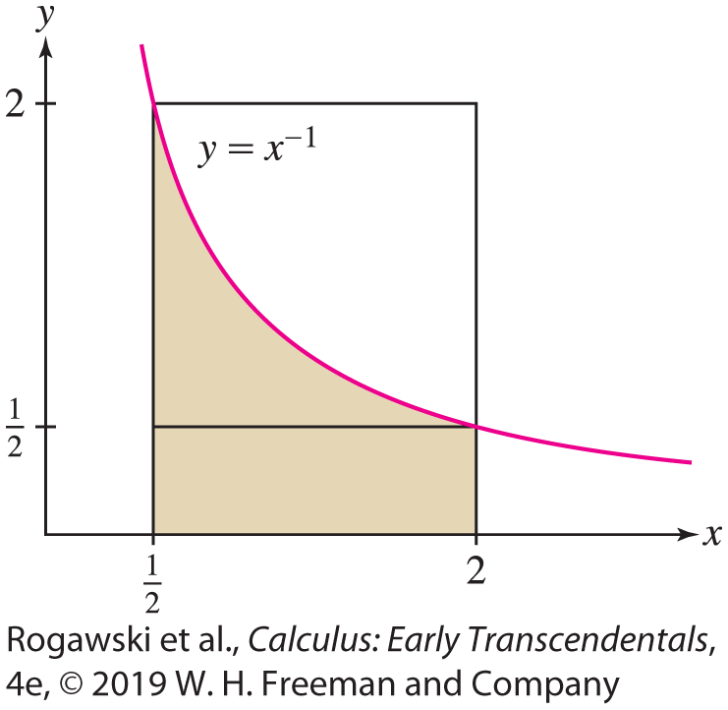

5.2 The Definite Integral (26 of 26)
EXAMPLE: Because f (x) = x ⁻¹ is decreasing (Figure 14), its minimum value on [$\frac{1}{2}, 2]$is
m = f (2) = $\frac{1}{2}$ and its maximum value is M = f $\left(\frac{1}{2}\right)=2.$ Therefore,
$\frac{3}{4}=\frac{1}{2}\left(2 − \frac{1}{2}\right)≤\int_{1/2}^{2}{\frac{1}{x}}dx≤2\left(2 −\frac{1}{2}\right)=3.$

Slide 50

5.3 The Indefinite Integral (1 of 15)
Given the derivative of an unknown function, can we find the function itself? For example, in physics, we may know the velocity v(t) (the derivative) and wish to compute the position s(t) of an object. Since s$′$(t) = v(t), this amounts to finding a function whose derivative is v(t). A function F whose derivative is f is called an antiderivative of f. Antiderivatives will turn out to be the key to evaluating definite integrals.
DEFINITION: Antiderivatives A function F is an antiderivative of f on an open interval (a, b) if F$′$(x) = f (x) for all x in (a, b).

Slide 51

5.3 The Indefinite Integral (2 of 15)
Examples:
F (x) = − cos x is an antiderivative of f (x) = sin x because for all values of x,
F$′$(x) = $\frac{d}{dx}$ (− cos x) = sin x = f (x)
F (x) = $\frac{1}{3}x^{3}$ is an antiderivative of f (x) = x² because for all values of x,
F$′$(x) = $\frac{d}{dx}$ ($\frac{1}{3}x^{3}$) = $x^{2}$ = f (x)
One critical observation is that antiderivatives are not unique. We are free to add a constant C because the derivative of a constant is zero, and so, if F$′$(x) = f (x ), then
(F (x) + C)’ = f (x). For example, $\frac{1}{3}x^{3} ,\frac{1}{3}x^{3}+5,\frac{1}{3}x^{3}−4$ are all antiderivatives of x ².

Slide 52

5.3 The Indefinite Integral (3 of 15)
Are there any antiderivatives of f other than those obtained by adding a constant to a given antiderivative F ? Our next theorem says that the answer is no if f is defined on an open interval (a, b).
THEOREM: The General Antiderivative Let y = F (x) be an antiderivative of y = f (x) on (a, b). Then every antiderivative on (a, b) is of the form y = F (x) + C for some constant C.
Proof
Assume y = G(x) is an antiderivative of y = f (x), and set H (x) = G(x) − F (x). Then H$′$(x) = G$′$(x) − F$′$(x) = f (x) − f (x) = 0. By the Corollary to the Mean Value Theorem in Section 4.3, H (x) must be a constant, say, H (x) = C - and therefore G(x) = F (x) + C.

Slide 53

5.3 The Indefinite Integral (4 of 15)
We often describe the general antiderivative of a function in terms of an arbitrary constant C, as in the following example.
EXAMPLE: To find the general antiderivative of f (x) = cos x , we observe that the function F(x) = sin x is an antiderivative of f (x) = cos x . The general antiderivative is the function
F(x) = sin x + C, where C is any constant.
The process of finding an antiderivative is called integration or antidifferentiation. We will see why in the next section, when we discuss the connection between antiderivatives and areas under curves given by the Fundamental Theorem of Calculus. Therefore, we begin using the integral sign $\int{f(x)}dx$as the standard notation for antiderivatives.

Slide 54

5.3 The Indefinite Integral (5 of 15)
NOTATION: Indefinite Integral The notation $\int{f(x)}dx=F\left(x\right)+C$ means F$′$(x) = f (x).
The expression f (x) appearing in the integral sign is called the integrand. The symbol dx is a differential. It is part of the integral notation and serves to indicate the independent variable. The constant C is called the constant of integration.
Some indefinite integrals can be evaluated by reversing the familiar derivative formulas. For example, we obtain the indefinite integral of y = x^{n} by reversing the Power Rule for derivatives.
THEOREM: Power Rule for Integrals $\int{x^{n}}dx=\frac{1}{n + 1}x^{n+1}+C$ for all n ≠ − 1.
This holds since $\frac{d}{dx}\left(\frac{1}{n + 1}x^{n+1}\right)=\frac{1}{n + 1}\left(n+1\right)x^{n}=x^{n}.$

Slide 55

5.3 The Indefinite Integral (6 of 15)
In words, the Power Rule for Integrals says that to integrate a power of x , “increase the power by one and divide by the new power.” Here are some examples:
$$\int{x^{5}dx=\frac{1}{6}x^{6}+C}$$
$$\int{x^{−9}dx=−\frac{1}{8}x^{−8}+C}$$
$$\int{x^{3/5}dx=\frac{5}{8}x^{8/5}+C}$$

Slide 56
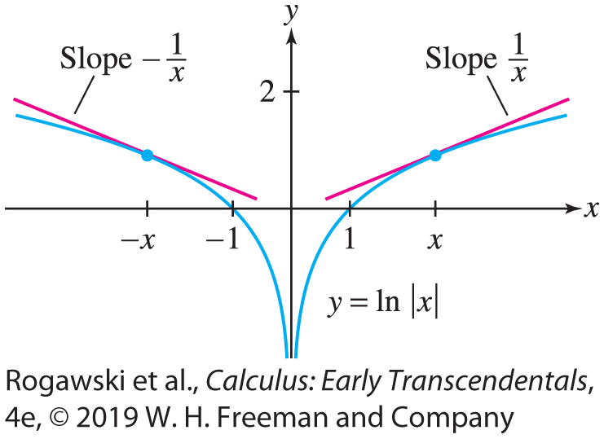

5.3 The Indefinite Integral (7 of 15)
The Power Rule is not valid for n = −1 because the expression $\frac{1}{n + 1}x^{n+1}$ is undefined for
n = − 1. However, the derivative of the natural logarithm is $\frac{d}{dx}\ln{x}=\frac{1}{x}$. This shows that
F (x) = ln x is an antiderivative of y = $\frac{1}{x}$. Thus, for n = −1, we have $\int{\frac{dx}{x}}=\ln{x}+C.$ This formula is valid for x > 0, where ln x is defined. We would like to have an antiderivative of y = $\frac{1}{x}$on its full domain, namely on {x : x ≠ 0}. To achieve this, we extend F (x) to an even function by setting F (x) = $\ln{|x|}$ (Figure 2). By the Chain
Rule, F$′$(x) = −F$′$(−x) since F(x) = F(−x). For x < 0, we
obtain$\frac{d}{dx}\ln\left|x\right|=F^{′}\left(x\right)=−F^{′}\left(−x\right)=−\frac{1}{−x}=\frac{1}{x}.$

Slide 57

5.3 The Indefinite Integral (8 of 15)
THEOREM: Antiderivative of y = $\frac{1}{x}$ The function F (x) = $\ln{|x|}$ is an antiderivative of y = $\frac{1}{x}$ in the domain {x : x ≠ 0}; that is, $\int{\frac{1}{x}}dx=\ln{|x|}+C.$
The indefinite integral obeys the usual linearity rules that allow us to integrate “term by term.” These rules follow from the linearity rules for the derivative (see Exercise 79).
THEOREM: Linearity of the Indefinite Integral
$\int{(f(x)}±g(x))dx=\int{f\left(x\right)}dx ± \int{g(x)}dx$
$\int{cf(x)}dx=c\int{f(x)}dx$

Slide 58

5.3 The Indefinite Integral (9 of 15)
EXAMPLE:
$\int{(3x^{4}−5x^{2/3}+x^{−3})}dx=3\frac{1}{5}x^{5}−5\frac{3}{5}x^{5/3}−\frac{1}{2}x^{−2}+C=\frac{3}{5}x^{5}−3x^{5/3}−\frac{1}{2}x^{−2}+C$
Check: $\frac{d}{dx}\left(\frac{3}{5}x^{5}−3x^{5/3}−\frac{1}{2}x^{−2}\right)=3x^{4}−5x^{2/3}+x^{−3}$
Although the linearity rules for the derivative carry over to linearity rules for indefinite integrals, there are no rules for directly computing indefinite integrals of products, quotients, and compositions of functions. At this point the best approach, if possible, is to convert the integrand algebraically so that the result is an integral that can be computed.
EXAMPLE: $\int{\frac{5x^{2} − 6}{x^{3}}}dx=\int{(\frac{5}{x}} −6x^{−3})dx=5\ln\left|x\right|+3x^{−2}+C$

Slide 59

5.3 The Indefinite Integral (10 of 15)
The differentiation formulas for the trigonometric functions give us the following integration formulas. Each formula can be checked by differentiation.
Basic Trigonometric Integrals
$\int{\sin{x}dx=−\cos{x}}+C$ $\int{\cos{x}}dx=\sin{x}+C$
$\int{\sec^{2}{x}}dx=\tan{x}+C$ $\int{\csc^{2}{x}}dx=−\cot{x}+C$
$\int{\sec{x\tan{x}}}dx=\sec{x}+C$ $\int{\csc{x\cot{x}}}dx=−\csc{x}+C$
EXAMPLE: $\int{(\sin{t}}+20\sec^{2}t) dt=−\cos{t}+20\tan{t}+C$

Slide 60

5.3 The Indefinite Integral (11 of 15)
The formula $\frac{d}{dx}$(e^{x} ) = e^{x} says that f (x) = e^{x} is its own derivative. But this means that
f (x) = e^{x} is also its own antiderivative. In other words, $\int{e^{x}}dx=e^{x}+C.$ More generally, for any constant k ≠ 0, $\int{e^{kx}}dx=\frac{1}{k}e^{kx}+C$.
EXAMPLE:
$\int{({3e}^{x}−4)}dx=3e^{x}−4x+C$
$\int{12e^{7−3x}}dx=\int{12e^{7}}e^{−3x}dx=12e^{7}\left(−\frac{1}{3}\right)e^{−3x}+C=−4e^{7−3x}+C$

Slide 61

5.3 The Indefinite Integral (12 of 15)
We can think of an antiderivative as a solution to the differential equation
$$\frac{dy}{dx}=f\left(x\right)$$
In general, a differential equation is an equation relating an unknown function and its derivatives. The unknown in the last equation is a function y = F (x) whose derivative is f (x).
There are infinitely many solutions to Eq. (2), namely all the functions of the form y = F (x) + C, where y = F (x) is an antiderivative of y = f (x).
However, we can specify a particular solution by imposing an initial condition—that is, by requiring that the solution satisfies y(x₀) = y₀ for some fixed values x₀ and y₀. A differential equation with an initial condition is called an initial value problem.

Slide 62

5.3 The Indefinite Integral (13 of 15)
EXAMPLE:
To solve $\frac{dy}{dx}=4x^{7}$ subject to the initial condition y(0) = 4, we first find the general antiderivative $\int{4x^{7}}dx=\frac{1}{2}x^{8}+C.$ Next, we choose C so that the initial condition is satisfied: From y(x) $=\frac{1}{2}x^{8}+C$, we have y(0) = 0 + C, and from the initial condition, we have y(0) = 4. This yields C = 4, and our solution is $y=\frac{1}{2}x^{8}+4.$
To solve $\frac{dy}{dt}=\sin{t}$ subject to the initial condition y(0) = 2, we first find the general antiderivative $\int{\sin{t}}dt=−\cos{t}+C.$ Next, we choose C so that the initial condition is satisfied: From y(x), we have y(0) = −$\cos{0}$ + C = −1 + C, and from the initial condition, we have y(0) = 2. This yields C = 3, and our solution is $y=\text{−}\cos{t}+3.$

Slide 63
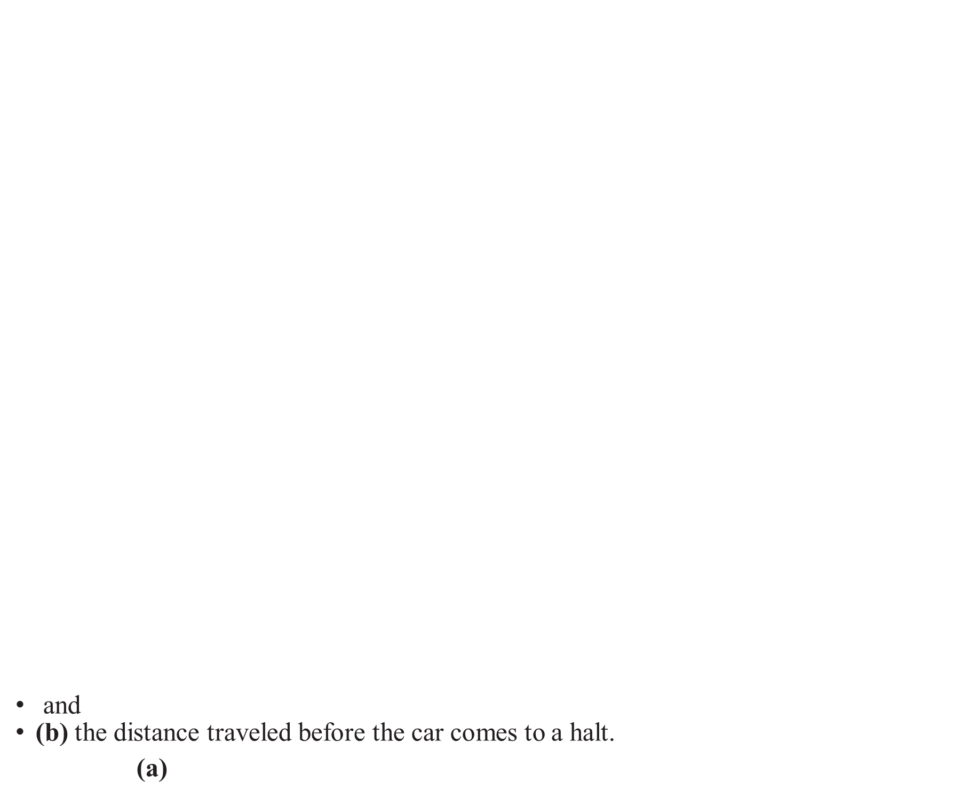
5.3 The Indefinite Integral (14 of 15)
EXAMPLE: A car traveling with velocity 24 m/s begins to slow down at time t = 0 with a constant acceleration of a = −6 m/s².
To find the velocity v(t) at time t, observe that the derivative of velocity is acceleration, so velocity is the antiderivative of acceleration: $v\left(t\right)=\int{a(t)}dt=\int{−6}dt=−6t+C.$ The initial condition v(0) = 24 yields C = 24 and therefore v(t) = −6t + 24 m/s.
Position is the antiderivative of velocity, so the car’s position in meters is given by the formula $s\left(t\right)=\int{v(t)}dt=\int{\left(−6t+24\right)}dt=−3t^{2}+24t+C_{1}$, where C₁ is a constant. We do not know where the car is at t = 0, so we set s(0) = 0, obtaining C₁ = 0. Therefore, we have s(t) = −3t ² + 24t as the distance traveled from time t = 0.
The car comes to a halt when v(t) = 0, so we solve 0 = v(t ) = −6t + 24, that is, t = 4 s. The distance traveled before coming to a halt is s(4) = −3(4²) + 24(4) = 48 m.
and
(b) the distance traveled before the car comes to a halt.
Solution (a)

Slide 64
5.3 The Indefinite Integral (15 of 15)
Antidifferentiation is generally a more difficult process than differentiaton. We will be developing indefinite integral formulas and techniques in the sections and chapters that follow. In this section, we derived a collection of integral formulas shown in the summary. In this text’s endleaf, there is a table of a few dozen integral formulas. Computer algebra systems such as Wolfram Alpha are excellent tools for computing integrals; they have made the process much easier than it used to be.

Slide 65

5.4 The Fundamental Theorem of Calculus, Part I (1 of 11)
The Fundamental Theorem of Calculus (FTC) is one of the most important theorems in all of Mathematics. It reveals an unexpected connection between differentiation and integration. The theorem has two parts. Although they are closely related, we discuss them in separate sections to emphasize the different ways they are used. The first part of the Fundamental Theorem of Calculus will allow us to compute definite integrals without having to take limits of Riemann sums. To explain FTC I, recall an example from Section 5.2:
$$\int_{4}^{7}{x^{2}}dx=\int_{0}^{7}{x^{2}}dx−\int_{0}^{4}{x^{2}}dx=\frac{7^{3}}{3}−\frac{4^{3}}{3}=93$$
Observe that $F\left(x\right)=\frac{1}{3}x^{3}$ is an antiderivative of $f\left(x\right)=x^{2}$ and $\int_{4}^{7}{x^{2}}dx=F\left(7\right)−F\left(4\right).$ According to FTC I, this is no coincidence; this relation between the definite integral and the antiderivative holds in general.

Slide 66

5.4 The Fundamental Theorem of Calculus, Part I (2 of 11)
THEOREM: The Fundamental Theorem of Calculus, Part I
Assume that a < b and that f is continuous on [a, b]. If F is an antiderivative of f on [a, b], then
$$\int_{a}^{b}{f(x)}dx=F\left(b\right)−F\left(a\right)$$
Proof
The quantity F (b) − F (a) is the total change in F (also called the net change) over the interval [a, b]. Our task is to relate it to the integral of F$′$(x) = f (x). There are two main steps.

Slide 67
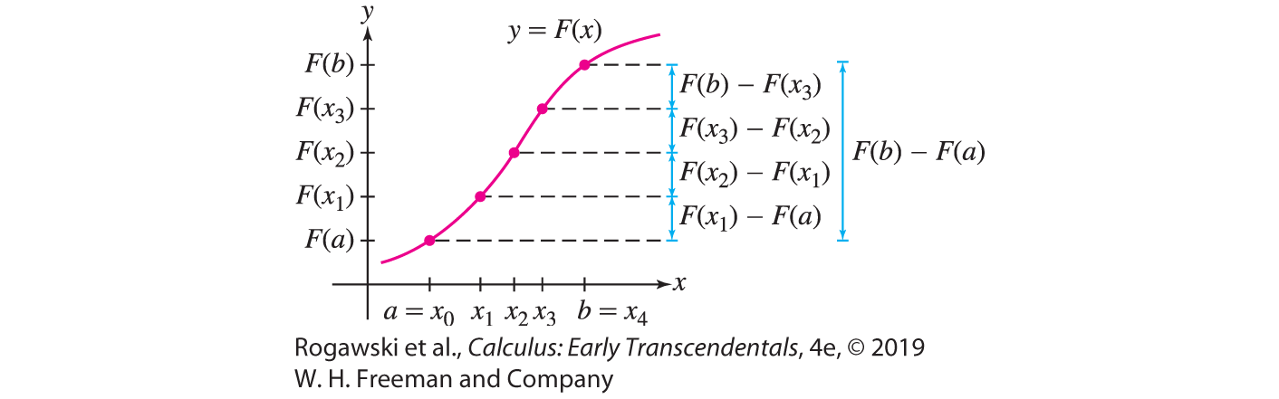

5.4 The Fundamental Theorem of Calculus, Part I (3 of 11)
Step 1. Write total change as a sum of small changes.
Given any partition P: x₀ = a < x₁ < x₂ < ··· < x_{N} = b of [a, b], we can break up F (b) − F (a) as a sum of changes over the intervals [x_{i −1}, x_{i} ]:
F (b) − F (a) = (F (b) − F (x_{N −1})) + (F (x_{N −1}) − F (x_{N −2})) + ··· + (F (x₂) − F (x₁)) + (F (x₁) − F (a))
$$=\sum_{i=1}^{N}{F\left(x_{i}\right)−F(x_{i−1)}})$$
On the right-hand side, −F (x_{N −1}) is canceled
by F (x_{N −1}) in the second term, −F (x_{N −2}) is
canceled by F (x_{N −2}) in the third term, and so on
(Figure 1).

Slide 68

5.4 The Fundamental Theorem of Calculus, Part I (4 of 11)
Step 2. Interpret Eq. (2) as a Riemann sum.
The Mean Value Theorem tells us that there is a point c∗ in [x_{i −1}, x_{i} ] such that
F (x_{i} ) − F (x_{i −1}) = $F′$($c_{i}^{∗}$)(x_{i} − x_{i −1}) = f ($c_{i}^{∗}$)(x_{i} − x_{i −1}) = f ($c_{i}^{∗}$) ∆x_{i}
Therefore, $F\left(b\right)−F\left(a\right)=\sum_{i=1}^{N}{F\left(x_{i}\right)−F(x_{i−1}})=\sum_{i=1}^{N}{f(c_{i}^{∗})∆x_{i}}$. This sum is the Riemann sum R( f , P, C∗) with sample points C∗ = {$c_{i}^{∗}$}.
Now, f is integrable (Section 5.2), so R( f , P, C∗) approaches $\int_{a}^{b}{f(x)}dx$ as the norm $|\left|P\right||$ tends to zero. On the other hand, R( f , P, C∗) is equal to F (b) − F (a) with our particular choice C∗ of sample points. This proves the desired result:
$$\int_{a}^{b}{f(x)}dx=\lim_{|\left|P\right||→0}{\text{R}\text{(} \text{f} \text{,} \text{P}\text{,} \text{C}\text{∗}\text{)}}=F\left(b\right)−F(a)$$

Slide 69

5.4 The Fundamental Theorem of Calculus, Part I (5 of 11)
FTC I tells us that if we can find an antiderivative of f , then we can compute the definite integral easily, without calculating any limits. It is for this reason that we use the integral sign for both the definite integral $\int_{a}^{b}{f(x)}dx$ and the indefinite integral (antiderivative) $\int{f(x)}dx$.
NOTATION: F (b) − F (a) is denoted $F(x)|_{a}^{b}$. In this notation, the FTC reads
$\int_{a}^{b}{f(x)}dx=F(x)|_{a}^{b}$, where $\int{f(x)}dx=F\left(x\right)+C$

Slide 70
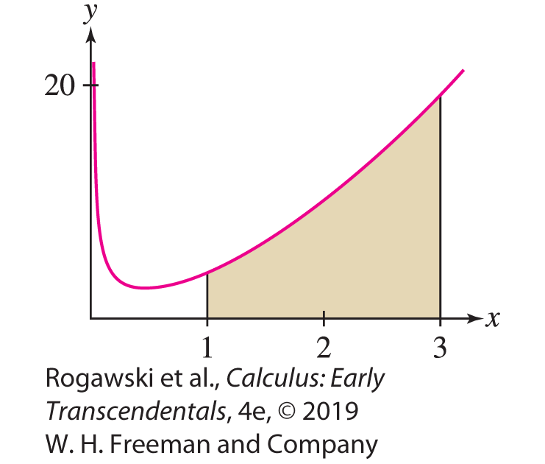

5.4 The Fundamental Theorem of Calculus, Part I (6 of 11)
EXAMPLE:
We calculate the area under the graph of f (x) = x ³ over [2, 4]. Since $\int{x^{3}}dx=\frac{1}{4}x^{4}+C$, we have $\int_{2}^{4}{x^{3}}dx=\frac{1}{4}x^{4}|_{2}^{4}=64−4=60.$
To find the area under g(x) = x ^{−3/4} + 3x ^{5/3} over [1, 3], observe
$$\int{(x^{−3/4}}+3x^{5/3})dx=4x^{1/4}+\frac{1}{8}x^{8/3}+C and$$
$$\int_{1}^{3}{(x^{−3/4}}+3x^{5/3})dx=4x^{1/4}+\frac{1}{8}x^{8/3}|_{1}^{3}=4∙3^{1/4}+\frac{1}{8}3^{8/3}−41^{1/4}+\frac{1}{8}1^{8/3}\text{≈} \text{26.32}\text{5} \text{−} \text{5.12}\text{5} \text{=} \text{21.2}$$

Slide 71

5.4 The Fundamental Theorem of Calculus, Part I (7 of 11)
Since $\int{x^{n}}dx=\frac{1}{n + 1}x^{n+1}+C$ for n ≠ 1, we have $\int_{0}^{b}{x^{n}}dx=\frac{1}{n + 1}b^{n+1}.$
EXAMPLE:
$\int_{0}^{π}{\sin{x}}dx=−\cos{x}|_{0}^{π}=(−\cos{π})−(−\cos{0})=−\left(−1\right)−\left(−1\right)=2$
$\int_{0}^{2π}{\sin{x}}dx=−\cos{x}|_{0}^{2π}=(−\cos{2π})−(−cos{0})=−1−\left(−1\right)=0$
$\int_{π/4}^{{3π}/4}{\sin{x}}dx=−\cos{x}|_{π/4}^{{3π}/4}=(−\cos{\frac{3π}{4}})−(−\cos{\frac{π}{4}})=−\left(−\frac{\sqrt{2}}{2}\right)−\left(−\frac{\sqrt{2}}{2}\right)=\sqrt{2}$

Slide 72
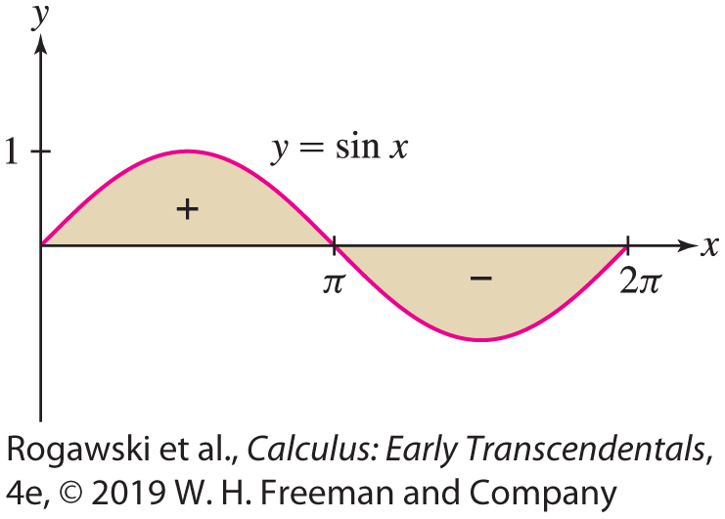
5.4 The Fundamental Theorem of Calculus, Part I (8 of 11)
It is interesting that the area under one hump of the sine graph (Figure 4) is a whole-number value, 2. Also, it is no surprise that the result of the second integral in this example is 0 since it corresponds to the signed area from 0 to 2π , and that value is zero since the contribution from the hump below the axis exactly cancels the contribution from the hump above.
In the last example in Section 5.1, we looked at R_{N} for the integral in (c). Directly taking the limit of R_{N} to get an exact value is difficult, but FTC I makes the process of obtaining the area easy: Antidifferentiate f(x) = sin x , evaluate the result at the endpoints, and take the difference.

Slide 73

5.4 The Fundamental Theorem of Calculus, Part I (9 of 11)
EXAMPLE: Probability density functions are used to calculate, via integration, the likelihood that an “event” has a value that lies within a specific range of values. The Eddington Bulb Company uses a probability density function p(t) = 0.001e^{−0.001t} to determine the likelihood of failure of their Cool-Lite refrigerator bulb over any interval of hours of use. We find the probability that a Cool-Lite bulb lasts for more than 500 hours of use.
The integral $\int_{0}^{500}{0.001e^{−0.001t}}dt$ gives the probability that a Cool-Lite bulb fails before 500 h of use. Subtracting this value from 1 provides the desired probability. To begin,
$\int{0.001e^{−0.001t}}dt=0.001\frac{−1}{0.001}e^{−0.001t}+C=−e^{−0.001t}+C$
The definite integral is $\int_{0}^{500}{0.001e^{−0.001t}}dt=−e^{−0.001t}|_{0}^{500}=−e^{−0.5}+1\text{≈} \text{0.39}$. It follows that the probability that a Cool-Lite bulb lasts for more than 500 h of use is ≈ 0.61.

Slide 74

5.4 The Fundamental Theorem of Calculus, Part I (10 of 11)
Recall (Section 5.3) that F (x) = $\ln{|x|}$ is an antiderivative of f (x) = x ⁻¹ in the domain
{x : x ≠ 0}. Therefore, FTC I yields the following formula that is valid if a and b are both positive or both negative [see Figure 5(A)]. Note that when a < 0 < b, FTC I does not apply since f is not continuous over [a, b].
$$\int_{a}^{b}{\frac{dx}{x}}=\ln{|b|}−\ln\left|a\right|=\ln\left|\frac{b}{a}\right|$$

Slide 75
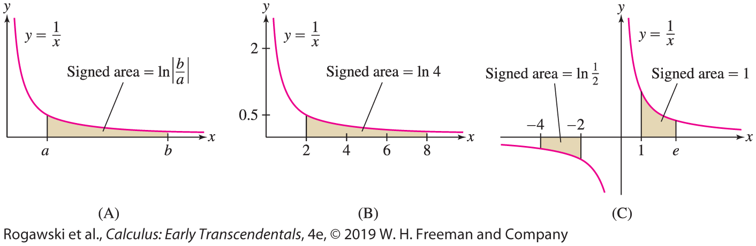

5.4 The Fundamental Theorem of Calculus, Part I (11 of 11)
EXAMPLE:
$\int_{2}^{8}{\frac{dx}{x}}=\ln{\frac{8}{2}}=\ln{4}\text{≈} \text{1.39}\text{,}$ $\int_{−4}^{−2}{\frac{dx}{x}}=\ln{\frac{|−2|}{|−4|}}=\ln{\frac{1}{2}}\text{≈} \text{−}\text{0.69}\text{,} \int_{1}^{e}{\frac{dx}{x}}=\ln{\frac{e}{1}}=\ln{e}=1$
(see Figure 5). We introduced the
number e in Section 1.6 as the
number for which the area under
y = 1/x from 1 to e is equal to 1.
We have now verified this fact via
a definite integral.

Slide 76
5.5 The Fundamental Theorem of Calculus, Part II (1 of 16)
Part I of the Fundamental Theorem says that we can compute definite integrals using indefinite integrals (antiderivatives). Part II does the opposite, providing a way to compute antiderivatives using definite integrals. Another interpretation of Part II of the FTC demonstrates how definite integration and differentiation are inverse processes. We will focus on that aspect of FTC II first, considering a motivating example before stating the theorem.
The idea behind this inverse relationship is as follows:
Start with a function f .
Create a new function A via definite integration of f. The function A is called an area function of f.
Differentiate A to return to the original function f.

Slide 77

5.5 The Fundamental Theorem of Calculus, Part II (2 of 16)
To begin, we introduce the area function of f with lower limit a:
$$A\left(x\right)=\int_{a}^{x}{f(t)}dt \text{=} \text{signed} \text{area} \text{from} \text{a} \text{to} \text{x}$$
For A(x) to be defined, f must be integrable over [a, x ] when x > a or over [x , a] when x < a. The definite integral defining A(x) yields a function because we regard the upper limit x as a variable.
Let us consider an example with f (x) = 4 − x ² and a = 1. The resulting area function is
$$A\left(x\right)=\int_{1}^{x}{(4−t^{2})}dt=4t−\frac{1}{3}t^{3}|_{1}^{x}=−\frac{1}{3}x^{3}+4x−\frac{11}{3}$$
Now, notice that if we differentiate this area function, the result is f , the function we started with: $A′$(x) = 4 − x ² = f (x).

Slide 78

5.5 The Fundamental Theorem of Calculus, Part II (3 of 16)
Thus, if we start with f , create an area function A, and then differentiate A, we return to f . Part II of the Fundamental Theorem of Calculus asserts that if f is continuous, then this relationship always holds:
THEOREM: Fundamental Theorem of Calculus, Part II
Assume that f is continuous on an open interval I and let a be in I . Then the area function
$$A\left(x\right)=\int_{a}^{x}{f(t)}dt$$
is an antiderivative of f on I ; that is, $A^{′}\left(x\right)=f(x)$. Equivalently,
$$\frac{d}{dx}\int_{a}^{x}{f(t)}dt=f\left(x\right)$$

Slide 79
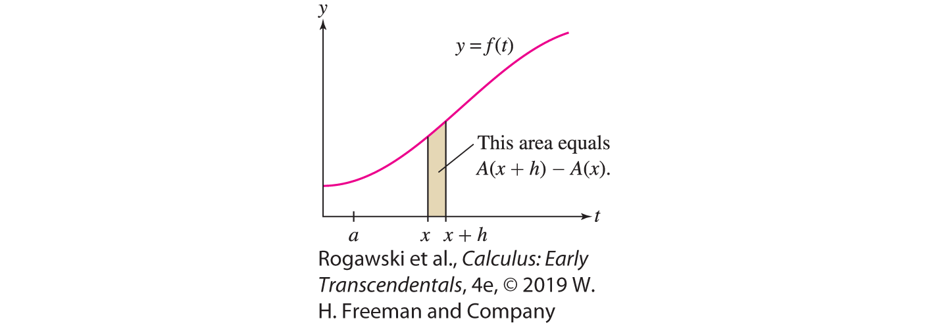

5.5 The Fundamental Theorem of Calculus, Part II (4 of 16)
Proof
First, we use the additivity property of the definite integral to write the change in
A over [x , x + h] as an integral:
$$A\left(x+h\right)−A\left(x\right)=\int_{a}^{x+h}{f\left(t\right)}dt−\int_{a}^{x}{f\left(t\right)}dt=\int_{x}^{x+h}{f(t)}dt$$
In other words, A(x + h) − A(x) is equal
to the area of the thin sliver between the
graph and the x-axis from x to x + h in
Figure 1.

Slide 80


5.5 The Fundamental Theorem of Calculus, Part II (5 of 16)
To simplify the rest of the proof, we assume that f is increasing (see Exercise 54 for the general case). Then, if h > 0, this thin sliver lies between the two rectangles of heights f (x) and f (x + h) in Figure 2, and we have
$$hf\left(x\right)≤A\left(x+h\right)−A\left(x\right)≤hf\left(x+h\right)$$
from which we get
$$f\left(x\right)≤\frac{A\left(x+h\right)−A\left(x\right)}{h}≤f\left(x+h\right)$$

Slide 81

5.5 The Fundamental Theorem of Calculus, Part II (6 of 16)
We have f (x + h) → f (x) as h → 0 because f is continuous. Thus, the Squeeze Theorem gives us
$$\lim_{h→0^{+}}{\frac{A\left(x+h\right)−A\left(x\right)}{h}}=f\left(x\right)$$
Since the case h < 0 can be treated similarly, we obtain
$$A^{′}\left(x\right)=\lim_{h→0}{\frac{A\left(x+h\right)−A\left(x\right)}{h}}=f\left(x\right)$$

Slide 82

5.5 The Fundamental Theorem of Calculus, Part II (7 of 16)
EXAMPLE: We compute an area function $A\left(x\right)=\int_{a}^{x}{f(t)}dt$ for
f (x) = $1−6x−\cos{x}$ with a = −𝜋 , and then verify the FTC II inverse relationship by showing that A$′$(x) = f (x):
$$A\left(x\right)=\int_{−π}^{x}{\left(1−6t−\cos{t}\right)}dt=\left(t−3t^{2}−\sin{t}\right)|_{−π}^{x}=x−3x^{2}−\sin{x}+π+3π^{2}$$
and
$$\frac{d}{dx}\left(x−3x^{2}−\sin{x}+π+3π^{2}\right)=1−6x−\cos{x}=f\left(x\right)$$
Thus, we see that when we start with f , compute an area function of it, and differentiate the area function, we obtain the function f back.

Slide 83
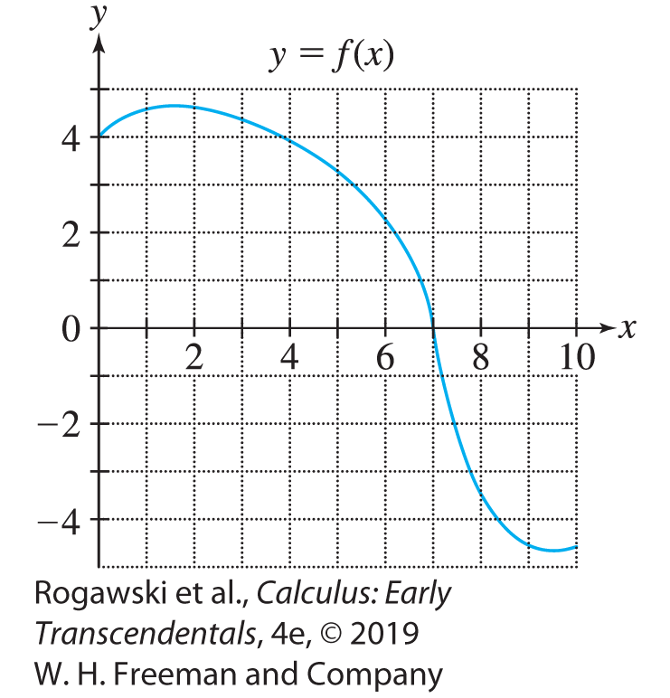

5.5 The Fundamental Theorem of Calculus, Part II (8 of 16)
EXAMPLE: A Numerically Approximate FTC II Verification Consider the function f that is presented graphically in Figure 3. Here, we will approximate an area function and its derivative to demonstrate (at least approximately) the FTC II inverse relationship. Let A be the area function defined by $A\left(x\right)=\int_{0}^{x}{f(t)}dt.$

Slide 84
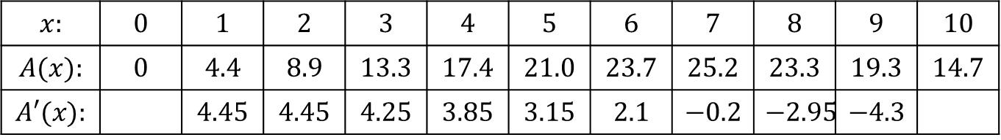

5.5 The Fundamental Theorem of Calculus, Part II (9 of 16)
To estimate the corresponding signed areas, we approximate A(x) for x = 0, 1, 2, ... , 10. First, note that $A\left(0\right)=\int_{0}^{0}{f(t)}dt=0$. For other x, we can estimate A(x) by counting the 1 × 1 squares (and partial squares) between the graph and the x-axis from 0 to x . For example, for A(1), we have 4.4 squares between the graph and the x-axis from x = 0 to x = 1. Therefore, A(1) ≈ 4.4. Continuing, we obtain the approximate values of A(x) shown in the table. Note that in determining the values for A(8) through A(10), each square below the x-axis contributes a value of −1 to the signed area.
$$x:$$ | $$0$$ | $$1$$ | $$2$$ | $$3$$ | $$4$$ | $$5$$ | $$6$$ | $$7$$ | $$8$$ | $$9$$ | $$10$$
$$A(x):$$ | $$0$$ | $$4.4$$ | $$8.9$$ | $$13.3$$ | $$17.4$$ | $$21.0$$ | $$23.7$$ | $$25.2$$ | $$23.3$$ | $$19.3$$ | $$14.7$$
$$A′(x):$$ |  | $$4.45$$ | $$4.45$$ | $$4.25$$ | $$3.85$$ | $$3.15$$ | $$2.1$$ | $$−0.2$$ | $$−2.95$$ | $$−4.3$$

Slide 85
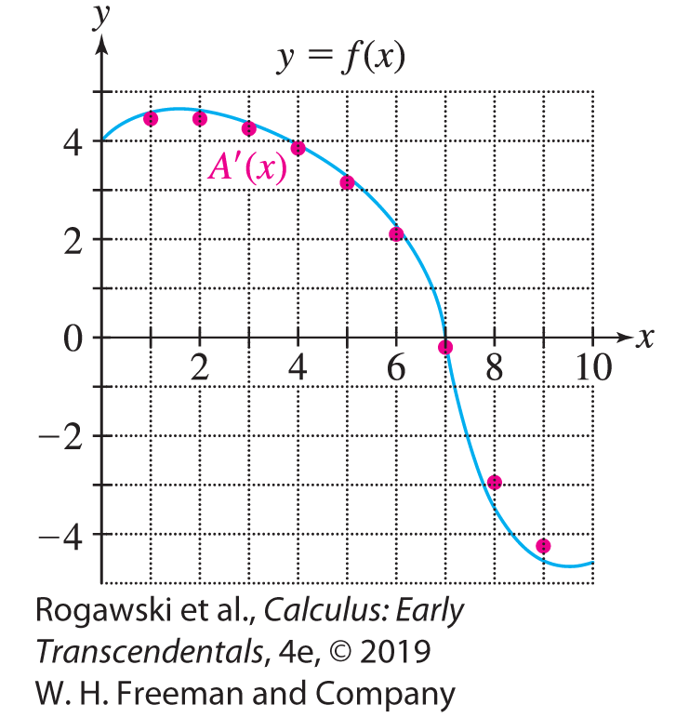


5.5 The Fundamental Theorem of Calculus, Part II (10 of 16)
We use the symmetric difference quotient approximation, $A′(x)≈\frac{A\left(x + ∆x\right) − A(x − ∆x)}{2∆x}$, with Δx = 1 to approximate $A^{′}\left(x\right)$ for x = 1, 2, ... , 9. We plot these values of $A′(x)$ on the graph of f to demonstrate $A′$ ≈ f . As a couple of examples, for x = 1 and x = 9, we obtain the following difference quotient approximations:
$$A^{′}\left(1\right)≈\frac{A\left(2\right)−A\left(0\right)}{2}=4.45,A^{′}\left(8\right)≈\frac{A\left(9\right)−A\left(7\right)}{2}=−4.3$$
$$x:$$ | $$0$$ | $$1$$ | $$2$$ | $$3$$ | $$4$$ | $$5$$ | $$6$$ | $$7$$ | $$8$$ | $$9$$ | $$10$$
$$A(x):$$ | $$0$$ | $$4.4$$ | $$8.9$$ | $$13.3$$ | $$17.4$$ | $$21.0$$ | $$23.7$$ | $$25.2$$ | $$23.3$$ | $$19.3$$ | $$14.7$$
$$A′(x):$$ |  | $$4.45$$ | $$4.45$$ | $$4.25$$ | $$3.85$$ | $$3.15$$ | $$2.1$$ | $$−0.2$$ | $$−2.95$$ | $$−4.3$$

Slide 86

5.5 The Fundamental Theorem of Calculus, Part II (11 of 16)
In addition to showing the inverse relationship between integration and differentiation, FTC II also reveals how area functions may be used to compute antiderivatives. Although we already have simple expressions for antiderivatives of f (x) = x ² and f (x) = cos x , the area-function version might not be helpful. On the other hand, for a function such as $f\left(x\right)=\sqrt[3]{1+\cos{x}}$, it is not possible to find an elementary function whose derivative is $f\left(x\right)=\sqrt[3]{1+\cos{x}}$. That does not mean that there is no antiderivative since FTC II guarantees that $A\left(x\right)=\int_{0}^{x}{\sqrt[3]{1+\cos{t}}}dt$ is an antiderivative, but expressing it in the area-function form might be the best we can do.
Unfortunately, the antiderivative A(x) does not yield a formula that we can use to compute definite integrals involving f via FTC I. Instead, we need to consider alternative approaches such as numerical approximation.

Slide 87

5.5 The Fundamental Theorem of Calculus, Part II (12 of 16)
While it might seem unfortunate that A(x) is the best that we can do for an antiderivative of $f\left(x\right)=\sqrt[3]{1+\cos{x}}$, as the next example shows, there is plenty that we can do to understand the behavior of A.
EXAMPLE: Let $A\left(x\right)=\int_{0}^{x}{\sqrt[3]{1+\cos{t}}}dt.$
For x = 1, 2, ... , 20, with Δx = 0.01, use technology to calculate a right-endpoint Riemann sum that approximates the definite integral defining A(x). Plot the points (x, A(x)) and connect them with a smooth curve to obtain a graph of A.
Examine A$′$ to determine the critical points of A and the increasing/decreasing behavior of the graph of A.

Slide 88
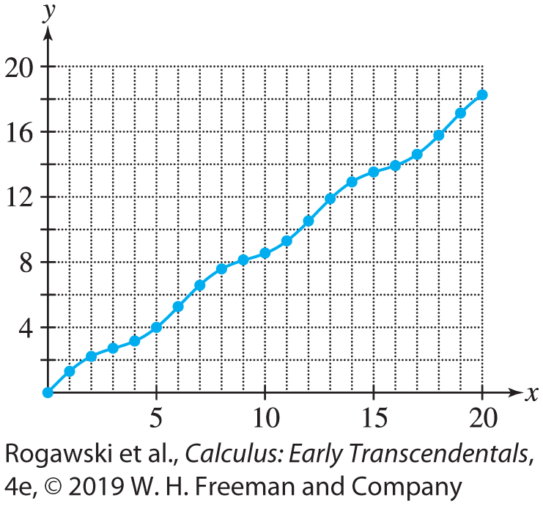
5.5 The Fundamental Theorem of Calculus, Part II (13 of 16)
Solution
a) We use Δx = 0.01 and a right-endpoint Riemann sum to approximate each definite integral. For example, to approximate A(4), we compute R₄₀₀ for the definite integral over [0, 4]. We obtain the following values for A(x):
These points are plotted and joined with a
smooth curve to obtain a graph of A in Figure 5.
$$x:$$ | $$1$$ | $$2$$ | $$3$$ | $$4$$ | $$5$$ | $$6$$ | $$7$$ | $$8$$ | $$9$$ | $$10$$
$$A(x)$$ | $$1.22$$ | $$2.24$$ | $$2.80$$ | $$3.19$$ | $$4.10$$ | $$5.29$$ | $$6.54$$ | $$7.63$$ | $$8.35$$ | $$8.66$$
$$x:$$ | $$11$$ | $$12$$ | $$13$$ | $$14$$ | $$15$$ | $$16$$ | $$17$$ | $$18$$ | $$19$$ | $$20$$
$$A(x):$$ | $$9.45$$ | $$10.58$$ | $$11.83$$ | $$12.99$$ | $$13.85$$ | $$14.18$$ | $$14.83$$ | $$15.89$$ | $$17.13$$ | $$18.33$$

Slide 89

5.5 The Fundamental Theorem of Calculus, Part II (14 of 16)
b) By FTC II, $A′\left(x\right)=\sqrt[3]{1+\cos{x}}$. It follows that A has critical points when $\cos{x}=−1$; that is, at nπ for all odd n. Furthermore, except at the critical points, $A′(x)$ is positive, and therefore A is an increasing function.

Slide 90

5.5 The Fundamental Theorem of Calculus, Part II (15 of 16)
EXAMPLE: Given $A\left(x\right)=\int_{2}^{x}{\sqrt{1+t^{3}}}dt$, we calculate or approximate A(2), A(3), A$′$(2), and A$′$(3).
$A\left(2\right)=\int_{2}^{2}{\sqrt{1+t^{3}}}dt=0.$
For $A\left(3\right)=\int_{2}^{3}{\sqrt{1+t^{3}}}dt,$ we need to approximate the definite integral because we do not have a simple antiderivative that enables us to compute the integral using FTC I. We compute an approximating Riemann sum, R₁₀₀, and find A(3) ≈ 4.11.
$A^{′}\left(2\right)=\sqrt{1+2^{3}}=3$.
${ A}^{′}\left(3\right)=\sqrt{1+3^{3}}=\sqrt{28}.$

Slide 91

5.5 The Fundamental Theorem of Calculus, Part II (16 of 16)
When the upper limit of the integral is a function of x rather than x itself, we use FTC II together with the Chain Rule to differentiate the integral.
EXAMPLE: If $G\left(x\right)=\int_{−2}^{x^{2}}{\sin{t}}dt$, then FTC II does not apply directly because the upper limit is x ² rather than x . It is necessary to recognize that G is a composite function with outer function $A\left(u\right)=\int_{−2}^{u}{\sin{t}}dt$and u = x². Then $\frac{dG}{dx}=\frac{dA}{du}\frac{du}{dx}=2x\sin{x^{2}}$ by the Chain Rule.

Slide 92

5.6 Net Change as the Integral of a Rate of Change (1 of 11)
Consider the following problem: Water flows into an empty bucket at a rate of r(t) liters per second. How much water is in the bucket after 4 seconds? If the rate of water flow were constant—say, 1.5 L/s—we would have
quantity of water = flow rate × time elapsed = (1.5)4 = 6 L
Suppose, however, that the flow rate r(t) varies as in Figure 1. Then the quantity of water is equal to the area under the graph of y = r(t). To prove this, let s(t) be the amount of water in the bucket at time t. Then s$′$(t) = r (t) because s$′$(t) is the rate at which the quantity of water is changing, that is, the rate that water is entering the bucket, r(t). Furthermore, s(0) = 0 because the bucket is initially empty. By FTC I,
$$area under the graph of the flow rate=\int_{0}^{4}{r(t)}dt=s\left(4\right)−s\left(0\right)=s\left(4\right)=water in bucket at t = 4$$

Slide 93

5.6 Net Change as the Integral of a Rate of Change (2 of 11)
More generally, s(t₂) − s(t₁) is the net change in s(t) over the interval [t₁, t₂]. FTC I yields the following result:
THEOREM: Net Change as the Integral of a Rate of Change
The net change in s(t) over an interval [t₁, t₂] is given by the integral
$$s\left(t_{2}\right)−s\left(t_{1}\right)=\int_{t_{1}}^{t_{2}}{s^{′}\left(t\right)}dt$$

Slide 94

5.6 Net Change as the Integral of a Rate of Change (3 of 11)
EXAMPLE: Water leaks from a tank at a rate of 2 + 5t liters/hour, where t is the number of hours after 7 am. How much water is lost between 9 and 11 am? Let s(t) be the quantity of water in the tank at time t. Since 2 + 5t represents the rate that the water is leaving that tank, the rate of change of the water in the tank is −(2 + 5t ). So s$′$(t) = −(2 + 5t ).
Since 9 and 11 am correspond to t = 2 and t = 4, respectively, the net change in s(t) between 9 and 11 am is
$$s\left(4\right)−s\left(2\right)=\int_{2}^{4}{s^{′}\left(t\right)}dt=\int_{2}^{4}{−\left(2+5t\right)}dt=−\left(2t+\frac{5}{2}t^{2}\right)|_{2}^{4}= \text{(}\text{−}\text{48}\text{)} \text{−} \text{(}\text{−}\text{14}\text{)} \text{=} \text{−}\text{3}\text{4}$$
The tank lost 34 L between 9 and 11 am.

Slide 95

5.6 Net Change as the Integral of a Rate of Change (4 of 11)
In the next example, we estimate an integral using numerical data. We shall compute the average of the left- and right-endpoint approximations, because this is usually more accurate than either endpoint approximation alone.
EXAMPLE: Traffic Flow The number of cars per hour passing an observation point along a highway is called the traffic flow rate q(t) (in cars per hour).
Which quantity is represented by the integral $\int_{\text{t}\text{1} }^{\text{t}\text{2}}{q(t)}dt$?
The flow rate on the Jocoro Highway is recorded at 15-minute intervals on Monday morning between 7:00 and 9:00 am. Estimate the number of cars using the highway during this 2-h period.
$$t$$ | $$7:00$$ | $$7:15$$ | $$7:30$$ | $$7:45$$ | $$8:00$$ | $$8:15$$ | $$8:30$$ | $$8:45$$ | $$9:00$$
$$q(t)$$ | $$1044$$ | $$1297$$ | $$1478$$ | $$1844$$ | $$1451$$ | $$1378$$ | $$1155$$ | $$802$$ | $$542$$

Slide 96

5.6 Net Change as the Integral of a Rate of Change (5 of 11)
The integral $\int_{\text{t}\text{1} }^{\text{t}\text{2}}{q(t)}$represents the total number of cars that passed the observation point during the time interval [t₁, t₂]. The data values are spaced at intervals of Δt = 0.25 h. Thus,
L_{N} = 0.25(1044 + 1297 + 1478 + 1844 + 1451 + 1378 + 1155 + 802) ≈ 2612
R_{N} = 0.25(1297 + 1478 + 1844 + 1451 + 1378 + 1155 + 802 + 542) ≈ 2487
We estimate the number of cars that passed the observation point between 7 and 9 am by taking the average of R_{N} and L_{N} :
$$\int_{\text{t}\text{1} }^{\text{t}\text{2}}{q(t)}=\frac{1}{2}\left(L_{N}+R_{N}\right)\text{≈} \text{2550}$$
Approximately 2550 cars used the Jocoro Highway during the time period.

Slide 97

5.6 Net Change as the Integral of a Rate of Change (6 of 11)
Let s(t) be the position at time t of an object in linear motion. Then the object’s velocity is v(t) = s$′$(t ), and the integral of v is equal to the net change in position or displacement over a time interval [t₁, t₂]:
$$\int_{t_{1}}^{t_{2}}{v(t)}dt=\int_{t_{1}}^{t_{2}}{s′(t)}dt=s\left(t_{2}\right)−s\left(t_{1}\right)$$
We must distinguish between displacement and distance traveled. If you travel 10 km and then return to your starting point, your displacement is zero but your distance traveled is 20 km. To compute distance traveled rather than displacement, we integrate the speed |v(t)|.

Slide 98
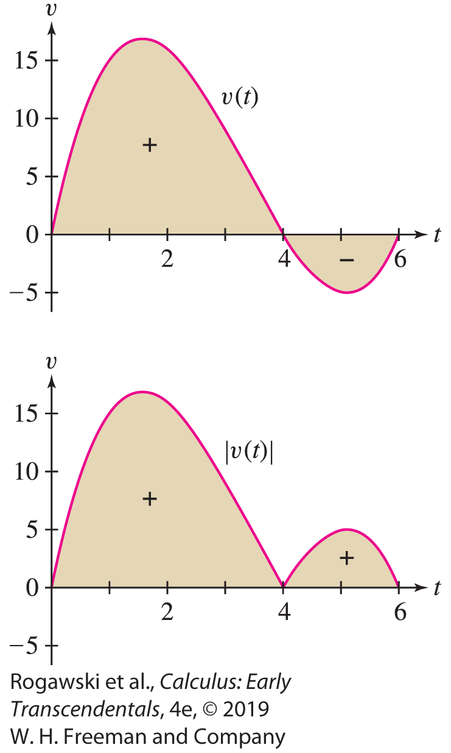

5.6 Net Change as the Integral of a Rate of Change (7 of 11)
THEOREM: The Integral of Velocity
For an object in linear motion with velocity v(t), then
$\text{displacemen}\text{t} \text{durin}\text{g}\text{ [}\text{t}\text{1}\text{,} \text{t}\text{2}\text{]} \text{=}\int_{t_{1}}^{t_{2}}{v(t)}dt$
$\text{distance} \text{traveled} \text{during}\text{ [}\text{t}\text{1}\text{,} \text{t}\text{2}\text{]} \text{=}\int_{t_{1}}^{t_{2}}{|v\left(t\right)|}dt$

Slide 99

5.6 Net Change as the Integral of a Rate of Change (8 of 11)
EXAMPLE: A particle has velocity v(t) = t ³ − 10t ² + 24t m/s. We compute:
Displacement over [0, 6]
Total distance traveled over [0, 6]
(a) First, we compute the indefinite integral: $\int{(\text{t} \text{3} \text{−} \text{10}\text{t} \text{2} \text{+} \text{24}\text{t}\text{)}}dt=\frac{1}{4}t^{4}−\frac{10}{3}t^{3}+12t^{2}+C$
The displacement over the time interval [0, 6] is
$$\int_{0}^{6}{(\text{t} \text{3} \text{−} \text{10}\text{t} \text{2} \text{+} \text{24}\text{t})}dt=\left(\frac{1}{4}t^{4}−\frac{10}{3}t^{3}+12t^{2}\right)|_{0}^{6}=36 m$$

Slide 100
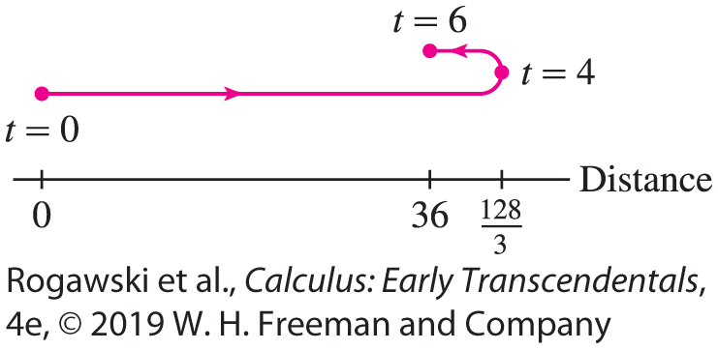

5.6 Net Change as the Integral of a Rate of Change (9 of 11)
(b) The factorization v(t) = t (t − 4)(t − 6) shows that v(t ) changes sign at t = 4. It is positive on [0, 4] and negative on [4, 6], as we see in Figure 2. Therefore, the total distance traveled is
$$\int_{0}^{6}{|v\left(t\right)|}dt=\int_{0}^{4}{v(t)}dt−\int_{4}^{6}{v(t)}dt$$
We evaluate these two integrals separately:
$\int_{0}^{4}{(\text{t} \text{3} \text{−} \text{10}\text{t} \text{2} \text{+} \text{24}\text{t})}dt=\left(\frac{1}{4}t^{4}−\frac{10}{3}t^{3}+12t^{2}\right)|_{0}^{4}=\frac{128}{3} m$
$\int_{4}^{6}{(\text{t} \text{3} \text{−} \text{10}\text{t} \text{2} \text{+} \text{24}\text{t})}dt=\left(\frac{1}{4}t^{4}−\frac{10}{3}t^{3}+12t^{2}\right)|_{4}^{6}=−\frac{20}{3} m$
The total distance traveled is $\frac{128}{3} m+\frac{20}{3} m=\frac{148}{3} m=49\frac{1}{3} m$.

Slide 101

5.6 Net Change as the Integral of a Rate of Change (10 of 11)
Let C(x) represent a manufacturer’s cost to produce x units of a particular product or commodity. The derivative C$′$(x) is called the marginal cost. The cost of increasing production from a units to b units is the net change C(b) − C(a), which is equal to the integral of the marginal cost:
$$\text{cost} \text{o}\text{f} \text{increasing} \text{p}\text{roduction} \text{from} \text{a} \text{units} \text{to} \text{b} \text{units} \text{=}\int_{a}^{b}{C′(x)}dx$$
EXAMPLE: The marginal cost of producing x computer chips (in units of 1000) is
C$′$(x) = 300x ² − 4000x + 40,000 (dollars per thousand chips)
Find the cost of increasing production from 10,000 to 15,000 chips.
Determine the total cost of producing 15,000 chips, assuming that it costs $30,000 to set up the manufacturing run [i.e., C(0) = 30,000].

Slide 102

5.6 Net Change as the Integral of a Rate of Change (11 of 11)
(a) The cost of increasing production from 10,000 (x = 10) to 15,000 (x = 15) is
$$\text{C}\text{(15}\text{)} \text{−} \text{C}\text{(10}\text{)} \text{=}\int_{10}^{15}{(\text{30}\text{0}\text{x} \text{2} \text{−} \text{400}\text{0}\text{x} \text{+} \text{40,000})}dx=$$
$$\text{= (}\text{10}\text{0}\text{x} \text{−} \text{200}\text{0}\text{x} \text{+} \text{40,00}\text{0}\text{x}\text{)}|_{10}^{15}\text{=} \text{\$187,500}$$
(b) The cost of increasing production from 0 to 15,000 chips is
$$\text{C}\text{(15}\text{)} \text{−} \text{C}\text{(0}\text{)} \text{=}\int_{0}^{15}{(\text{30}\text{0}\text{x} \text{2} \text{−} \text{400}\text{0}\text{x} \text{+} \text{40,000})}dx=$$
$$\text{= (10}\text{0}\text{x} \text{−} \text{200}\text{0}\text{x} \text{+} \text{40,00}\text{0}\text{x}\text{)}|_{0}^{15}\text{=} \text{\$487,500}$$
The total cost of producing 15,000 chips includes the set-up costs of $30,000:
C(15) = C(0) + 487,500 = 30,000 + 487,500 = $517,500

Slide 103

5.7 The Substitution Method (1 of 14)
Integration (antidifferentiation) is generally more difficult than differentiation. There are no sure-fire methods, and many antiderivatives cannot be expressed in terms of elementary functions. However, there are a few important general techniques. One such technique is the Substitution Method, which is essentially an inverse of the Chain Rule for Differentiation.
Consider the integral $\int{2x}cos{x^{2}}dx.$We can evaluate it if we remember the Chain Rule calculation: $\frac{d}{dx}\sin{x^{2}}=2x\cos{x^{2}}$. This tells us that sin(x ²) is an antiderivative of 2x cos(x ²), and therefore,
$$\int{2x\cos{x^{2}}}dx=\sin{x^{2}}+C$$

Slide 104

5.7 The Substitution Method (2 of 14)
A similar Chain Rule calculation shows that
$$\int{\left(1+3x^{2}\right)\cos\left(x+x^{3}\right)dx=\sin{(x+x^{3})}}+C$$
In both cases, the integrand is the product of a composite function and the derivative of the inside function.
The Chain Rule does not help if the derivative of the inside function is missing. For instance, we cannot use the Chain Rule to compute $\int{\cos\left(x^{3}\right)dx}$ because the factor (1 + 3x ²) does not appear.

Slide 105

5.7 The Substitution Method (3 of 14)
In general, if F$′$(u) = f (u), then by the Chain Rule,
$$\frac{d}{dx}F\left(u\left(x\right)\right)=F^{′}\left(u\left(x\right)\right)u^{′}\left(x\right)=f\left(u\left(x\right)\right)u′(x)$$
This translates into the following integration formula:
THEOREM: The Substitution Method
If F$′$(x ) = f (x ), and u is a differentiable function whose range includes the domain of f , then
$$\int{f\left(u\left(x\right)\right)u^{′}\left(x\right) =}F\left(u\left(x\right)\right)+C$$

Slide 106

5.7 The Substitution Method (4 of 14)
Substitution Using Differentials
Before proceeding to the examples, we discuss the procedure for carrying out substitution using differentials. We can treat the symbols du and dx that occur in integration as differentials, and in that way can use the relationship $du=\frac{du}{dx}dx$ to symbolically substitute into integrals in order to simplify them. Equivalently, du and dx are related by $du=u^{′}\left(x\right)dx.$
If $u=x^{2}$, then $du=2xdx.$
If $u=\cos\left(x^{3}\right),$then $du=−3x^{2}\sin\left(x^{3}\right).$

Slide 107

5.7 The Substitution Method (5 of 14)
Now, when the integrand has the form f (u(x)) u$′$(x), we can rewrite the entire integral (including the dx term) in terms of u and its differential du:
This equation is called the Change of Variables Formula. It transforms an integral in the variable x into a (hopefully simpler) integral in the new variable u.

Slide 108

5.7 The Substitution Method (6 of 14)
EXAMPLE:
a) To evaluate $\int{3x^{2}}\sin{x^{3}}dx$, we consider $u=x^{3}$, from which we get $du=3x^{2}dx.$ Now,
$$\int{3x^{2}}\sin{{(x}^{3})}dx=\int{\sin{{(x}^{3})}}\left(3x^{2}dx\right)=\int{\sin{u}}du=−\cos{u}+C=−\cos{x^{3}}+C$$
b) To evaluate $\int{x{\left(x^{2}+9\right)}^{5}}dx,$we consider $u=x^{2}+9$, from which we get $du=2xdx$or $\frac{1}{2}du=xdx.$ Now,
$$\int{x{\left(x^{2}+9\right)}^{5}}dx=\int{{\left(x^{2}+9\right)}^{5}}\left(xdx\right)=\int{u^{5}}\frac{1}{2}du=\frac{1}{2}\int{u^{5}}du=\frac{1}{12}u^{6}+C={\left(x^{2}+9\right)}^{6}+C$$

Slide 109

5.7 The Substitution Method (7 of 14)
EXAMPLE:
To evaluate $\int{\frac{\left(x^{2} + 2x\right)dx}{{\left(x^{3} + 3x^{2} + 12\right)}^{6}}},$ we set $u=\text{x} \text{3} \text{+} \text{3}\text{x} \text{2} \text{+} \text{12}$ and obtain
$du=\left(3x^{2}+6x\right)dx=3\left(x^{2}+2x\right)dx$
Therefore, $\frac{1}{3}du=\left(x^{2}+2x\right)dx$ and
$$\int{\frac{\left(x^{2}+2x\right)dx}{{\left(x^{3}+3x^{2}+12\right)}^{6}}}=\int{\frac{\frac{1}{3}du}{u^{6}}}=\frac{1}{3}\int{u^{−6}}du=−\frac{1}{15}u^{−5}+C=−\frac{1}{15}{\left(x^{3}+3x^{2}+12\right)}^{−5}+C$$

Slide 110

5.7 The Substitution Method (8 of 14)
EXAMPLE:
To evaluate $\int{\sin\left(7θ+5\right)}dθ$, we set $u=7θ+5$, from which we obtain $\frac{1}{7}du=dθ:$
$$\int{\sin\left(7θ+5\right)}dθ=\int{\sin{u}}\frac{1}{7}du=−\frac{1}{7}\cos{u}+C=−\frac{1}{7}\cos\left(7θ+5\right)+C$$
To evaluate $\int{e^{−9t}}dt$, we set $u=−9t$, from which we obtain $−\frac{1}{9}du=dt:$
$$\int{e^{−9t}}dt=−\frac{1}{9}\int{e^{u}}du=−\frac{1}{9}e^{u}+C=−\frac{1}{9}e^{−9t}+C$$

Slide 111

5.7 The Substitution Method (9 of 14)
Antiderivatives of sin θ and cos θ came naturally to us from the corresponding derivative formulas. However, we have not yet found an antiderivative for tan θ . We can obtain one now using the Substitution Method.
EXAMPLE:
$$\int{\tan{x}}dx=\int{\frac{1}{\cos{x}}}\left(\sin{x}dx\right)=\int{\frac{1}{u}(−du)}=−\ln\left|u\right|+C=−\ln{|\cos{x}}|+C=\ln{|sec{x}|}+C$$
where we use the substitution $u=\cos{x}$ which gives $−du=\sin{x}dx.$
A similar calculation shows $\int{\cot{x}}dx=\ln{|\sin{x}|}+C.$

Slide 112

5.7 The Substitution Method (10 of 14)
EXAMPLE: To evaluate $\int{x\sqrt{5x+1}}dx$, we make the substitution $u=5x+1$ which gives $\frac{1}{5}du=dx.$ Then $\int{x\sqrt{5x+1}}dx=\int{x\sqrt{u}\frac{1}{5}}du.$ To take care of the extra factor of x , we solve u = 5x + 1 to obtain $x=\frac{1}{5}\left(u−1\right).$Thus,
$$\int{x\sqrt{5x+1}}dx=\int{x\sqrt{u}\frac{1}{5}}du=\frac{1}{25}\int{(u−1)\sqrt{u}}du=\frac{1}{25}\int{\left(u^{3/2}−u^{1/2}\right)du}$$
$$=\frac{1}{25}\left(\frac{2}{5}u^{5/2}−\frac{2}{3}u^{3/2}\right)+C=\frac{2}{125}{\left(5x+1\right)}^{5/2}−\frac{2}{75}{\left(5x+1\right)}^{3/2}+C$$

Slide 113

5.7 The Substitution Method (11 of 14)
The Change of Variables Formula can be applied to definite integrals provided that the limits of integration are changed, as indicated in the next theorem.
Change of Variables Theorem for Definite Integrals
If u$′$ is continuous on [a, b], and f is continuous on the range of u, then
$$\int_{a}^{b}{f\left(u\left(x\right)\right)u′(x)}dx=\int_{u(a)}^{u(b)}{f(u)}du$$

Slide 114

5.7 The Substitution Method (12 of 14)
Proof
If F (x) is an antiderivative of f (x), then F (u(x)) is an antiderivative of f(u(x))u$′$(x ). FTC I shows that the two integrals are equal:
$$\int_{a}^{b}{f\left(u\left(x\right)\right)u′(x)}dx=F\left(u\left(b\right)\right)−F\left(u\left(a\right)\right)=\int_{u(a)}^{u(b)}{f(u)}du$$
EXAMPLE: To evaluate $\int_{0}^{2}{x^{2}\sqrt{x^{3}+1}}dx$, we make the substitution $u=x^{3}+1$ which gives $\frac{1}{3}du=x^{2}dx, u\left(0\right)=1$and $u\left(2\right)=9.$ Therefore,
$$\int_{0}^{2}{x^{2}\sqrt{x^{3}+1}}dx=\int_{0}^{2}{\sqrt{x^{3}+1}}\left(x^{2}dx\right)=\frac{1}{3}\int_{1}^{9}{\sqrt{u}}du=\frac{1}{3}\left(\frac{2}{3}u^{3/2}|_{1}^{9}\right)=\frac{2}{9}\left(9^{3/2}−1\right)=\frac{52}{9}$$

Slide 115
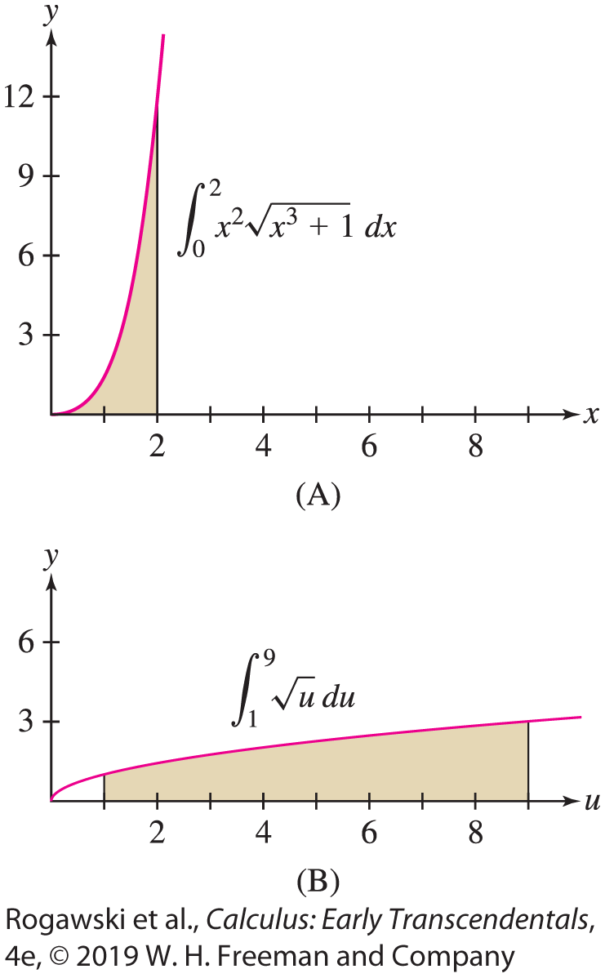

5.7 The Substitution Method (13 of 14)
This substitution shows that the area in (A) in Figure 1 is equal to one-third of the area in (B).
In the previous example, we can avoid changing the limits of integration by evaluating the indefinite integral in terms of x:
$$\int{x^{2}\sqrt{x^{3}+1}}dx=\frac{1}{3}\int{\sqrt{u}}du=\frac{2}{9}{(x^{3}+1)}^{3/2} + C$$

Slide 116
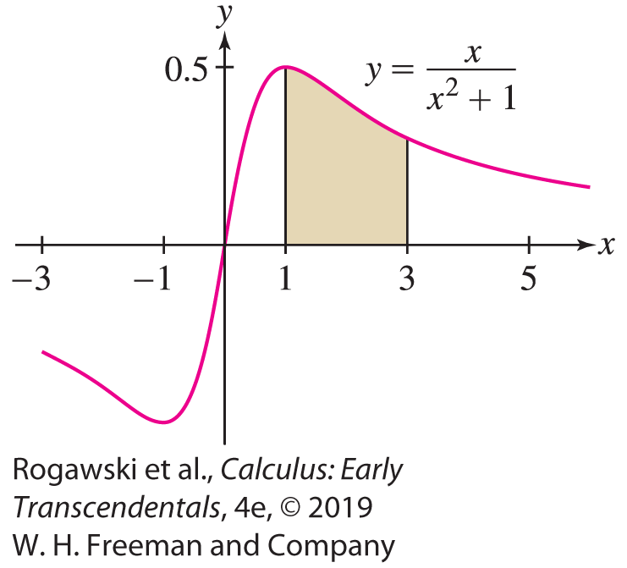

5.7 The Substitution Method (14 of 14)
EXAMPLE:
$\int_{0}^{π/4}{\tan^{3}θ\sec^{2}}θdθ=\int_{0}^{1}{u^{3}}du=\frac{1}{4}u^{4}|_{1}^{4}=\frac{1}{4}$ with the
substitution $u=\tan{θ}$, $du=\sec^{2}θdθ, u\left(0\right)=0$ and $u\left(\frac{π}{4}\right)=1.$
The area under $y=\frac{x}{x^{2} + 1}$ with x in [1, 3] is
$\int_{1}^{3}{\frac{xdx}{x^{2} + 1}}=\frac{1}{2}\int_{2}^{10}{\frac{du}{u}}=(\frac{1}{2}\ln\left|u\right|)|_{2}^{10}$ $=\frac{1}{2}\left(\ln{10}−\ln{2}\right)=\frac{1}{2}\ln{5}$
with the substitution $u=x^{2}+1,$ $\frac{1}{2}du=xdx$, $u\left(1\right)=2$
and $u\left(3\right)=10.$

Slide 117
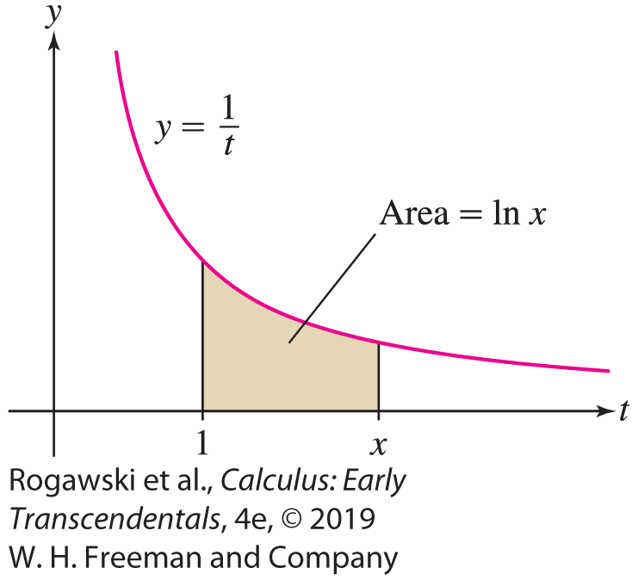
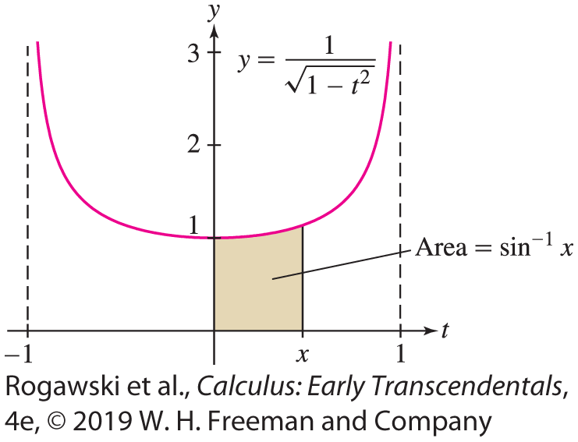

5.8 Further Integral Formulas (1 of 5)
We showed $\int_{a}^{b}{\frac{1}{x}}dx=\ln{\frac{|b|}{\left|a\right|}}.$ We obtain a formula for ln x as a definite integral by setting a = 1 and b = x and keeping in mind that ln 1 = 0: $\ln{x}=\int_{1}^{x}{\frac{1}{t}}dt.$ Thus, ln x is equal to an area under the hyperbola y = 1/t from 1 to x (Figure 1).
In a similar fashion, we can express sin⁻¹ x as a definite integral using the derivative formula from Section 3.8 (Figure 2):
$\frac{d}{dx}\sin^{−1}{x}=\frac{1}{\sqrt{1−x^{2}}}$ yields $\int{\frac{1}{\sqrt{1−x^{2}}}}dx=\sin^{−1}{x}+C$. Since $\sin^{−1}{0}=0,$ we get $\sin^{−1}{x}=\int_{0}^{x}{\frac{1}{\sqrt{1 − t^{2}}}}dt.$

Slide 118
5.8 Further Integral Formulas (2 of 5)
On the other hand, the derivative formulas from Section 3.8 yield integration formulas that are useful for evaluating new types of integrals.

Slide 119

5.8 Further Integral Formulas (3 of 5)
In this list, we omit the integral formulas corresponding to the derivatives of y = cos⁻¹ x , y = cot⁻¹ x , and y = csc⁻¹ x because their derivatives are the negative of the derivatives of y = sin⁻¹ x, y = tan⁻¹ x , and y = sec⁻¹ x , respectively. The omitted derivatives do not result in antiderivative formulas for new functions, just alternate formulas for functions for which we have a formula above. For example,
$$\int{\frac{1}{\sqrt{1−x^{2}}}}dx=−\cos^{−1}{x}+C$$

Slide 120

5.8 Further Integral Formulas (4 of 5)
EXAMPLE:
$\int_{0}^{1}{\frac{dx}{1 + x^{2}}}= \tan^{−1}{x}|_{0}^{1}=\tan^{−1}{1}−\tan^{−1}{0}=\frac{π}{4}.$
$\int_{1/{\sqrt{2}}}^{1}{ \frac{1}{x\sqrt{4x^{2} − 1}}}dx=\int_{\sqrt{2}}^{2}{\frac{1}{u\sqrt{u^{2} − 1}}}du=\sec^{−1}{u|_{\sqrt{2}}^{2}}=\sec^{−1}{2}−\sec^{−1}{\sqrt{2}}=\frac{π}{3}−\frac{π}{4}=\frac{π}{12}$ using the substitution u = 2x.
To evaluate $\int_{0}^{3/4}{\frac{1}{\sqrt{9 − 16x^{2}}}}dx$, we observe $\sqrt{9 −16x^{2}}=3\sqrt{1−{(\frac{4}{3}x)}^{2}}=3\sqrt{1−u^{2}}$ with the substitution $u=\frac{4}{3}x$. Hence, $dx=\frac{3}{4}du$, $u\left(0\right)=0$ and $u\left(\frac{3}{4}\right)=1:$
$$\int_{0}^{3/4}{\frac{1}{\sqrt{9 −16x^{2}}}}dx=\int_{0}^{1}{\frac{3/4du}{3\sqrt{1−u^{2}}}}=\frac{1}{4}\int_{0}^{1}{\frac{du}{\sqrt{1−u^{2}}}}=\sin^{−1}{u}|_{0}^{1}=\frac{π}{8}$$

Slide 121

5.8 Further Integral Formulas (5 of 5)
The exponential function f (x) = e^{x} is particularly convenient because e^{x} is both its own derivative and its own antiderivative. For other bases b, we have
$\frac{d}{dx}b^{x}=\ln{b}b^{x}$ which gives us $\int{b^{x}}dx=\frac{1}{\ln{b}}b^{x}+C$ as long as b ≠ 1.
EXAMPLE:
$\int_{3}^{5}{7^{x}}dx=\frac{1}{\ln{7}}7^{x}|_{3}^{5}=\frac{1}{\ln{7}}\left(7^{5}−7^{3}\right)$
$\int_{0}^{π/2}{\cos{θ}}{10}^{\sin{θ}}dθ=\int_{0}^{1}{{10}^{u}}du=\frac{1}{\ln{10}}{10}^{x}|_{0}^{1}=\frac{9}{\ln{10}}$ using the substitution $u\sin{θ,}$ $du=\cos{θ}dθ$, $u\left(0\right)=0$ and $u\left(\frac{π}{2}\right)=1.$

